Slide 1

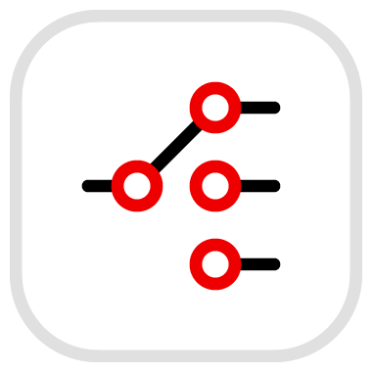
Apache Camel
and
Enterprise Integration

Slide 2
What we’ll discuss today
Agenda
Why enterprise integration?
Handling the differences between the systems
Camel Concepts and Constructs
Integration patterns
Enterprise integration modernization

Slide 3

Organizational integration challenges
Accelerate and modernize your applications
Integrating Disparate Systems
Complex Integration Landscape
Ensuring Reliability and Performance
benefit
risk
protocols
formats
availability
data
Overcoming technological incompatibilities
Ensuring data consistency across different platforms
Maintaining operational efficiency
Complexity of creating effective integration strategies
Selecting the most appropriate approach for each integration scenario
Failing or underperforming integration
Handling high volume of data
Providing high availability and fault tolerance
Notes:
Processed data

Slide 4






Why Enterprise Integration?
Make applications, data, and devices working together as a cohesive and efficient system
Reliable and cost-effective modernization
Utilization of integration best practices and patterns
Standardization of system communication using open standards
Notes:
Faster adoption of emerging technologies
Ensure consistency and accuracy across the organization
Embrace new technologies and smoothly modernize while leveraging existing investments
Faster onboarding of new applications, services and systems
Ease data exchange of critical information
Enable agile and proactive decision-making and quickly adjust to time-sensitive policy changes without updating end-user applications
Add anonymity between producers and consumers of data and protect data and resources during integration
Avoid large rewrites when changing integrations. Custom-built, one-off integrations are inefficient, unreliable, and costly
Employees can focus on high-value tasks

Slide 5
Handling the differences between the systems
Enterprise integration scenario needs
Service consumer
Service
What is the primary objective of the integration?
What are the interface specifications?
What do we need to do with the message?
When do events occur?
Are there specific performance targets or SLAs?
How are authentication and authorization handled in both systems?
What are the error handling and retry mechanisms in case of failed requests or responses?
Are there any rate limiting or quota restrictions imposed by the service provider?
Does the requester need to ensure (eventual) consistency?
Will the requester produce duplicate requests?
Should the requester get access to all data?
and many more questions…
Notes:
integrations require expert knowledge

Slide 6
Connect messaging systems
Message bridge
Legacy message broker (producer)
Message Bridge Integration
AMQ message broker (consumer)
JMS
JMS/AMQP
Sensors on edge devices / broker (producer)
Message Bridge Integration
Kafka broker (consumer)
MQTT events
Kafka events
Protocol translation
Message transformation
Routing
Enrichment and filtering
Key considerations
  Performance
  Compliance
Notes:
Solving a problem: System components operate on different schedules or have varying processing capacities

Slide 7
Facilitate flow of data between systems
Data integration
Data Migration
Data Processing
Data Synchronization
Enable advanced data analytics and AI applications using pipes and filters
Refine raw data into actionable and valuable insights using normalizer, enricher, aggregator and other patterns
Modernize systems while synchronizing data using change data capture and strangler patterns

Slide 8



Gather and prepare data in automated flows
Data pipeline
Data Ingestion
Data Transformation
Data Storage
Extend knowledge and improve accuracy in classification, recommendation, and other types of AI/ML-empowered applications
Optimize supply chains by collecting data from suppliers, inventory and logics systems
Analyze data from IoT devices by monitoring performance and detect failures
Notes:
Data pipeline is a workflow consisting of tasks that collect, move, and transform raw data from one or more data sources to a data storage
Designed to handle varying volumes and types of data
Extract-transform-load (ETL) pipeline extracts data from the source system, transform it into the desired format, and load it into the target system.
Extract-load-transform (ELT) pipelines are popular in the cloud-native solutions - transformations can scale horizontally, handling varying volumes of data more efficiently than traditional ETL pipelines

Slide 9

Exchange and translate data
Message processing
Data Formats
XML
JSON
Zipfile
Avro
Protobuf
SOAP
Expression Languages
JQ
JSONPath
XPath
XQuery
Transformation languages and frameworks
XSLT, JSLT, XJ
Bindy, Mapstruct, JAXB, Gson, Xstream
Validate
Enrich
Aggregate
Transform
Store
Route
Message data
Schema registry
Data source(s)
Notes:
Validate: Check incoming data for correctness and completeness to prevent errors and inconsistencies downstream.
Data format
Data type
Value ranges
Enrich: Incorporate related data from other sources to make incoming data more complete and useful
Transform: Convert data from one format or structure to another to align data with the target system interface
Format transformation - JSON <=> XML
Data transformation - 1:1, N:1, merging, complex manipulations

Slide 10
Bridge different API architectural styles
Service mediator
Service consumer
REST-SOAP Integration
Legacy system
OpenAPI contract
WSDL contract
openapi: 3.0.0
info:
title: WeatherService
description: Provides weather information
version: "1.0.0"
servers:
- url: 'http://example.com/weatherservice'
paths:
/weather:
get:
summary: Get weather information
description: Returns weather information for a given city
parameters:
- in: query
name: city
required: true
schema:
type: string
description: The name of the city
responses:
'200':
description: Successful response
content:
application/json:
schema:
type: object
properties:
temperature:
type: number
description: The current temperature
description:
type: string
description: A brief description of the weather conditions
JSON
Data format transformation
XML-SOAP
<?xml version="1.0" encoding="UTF-8"?>
<wsdl:definitions xmlns:soap="http://schemas.xmlsoap.org/wsdl/soap/"
xmlns:wsdl="http://schemas.xmlsoap.org/wsdl/"
xmlns:xsd="http://www.w3.org/2001/XMLSchema"
targetNamespace="http://example.com/weatherservice"
xmlns:tns="http://example.com/weatherservice">
<wsdl:types>
<xsd:schema targetNamespace="http://example.com/weatherservice">
<xsd:element name="GetWeatherRequest">
<xsd:complexType>
<xsd:sequence>
<xsd:element name="City" type="xsd:string"/>
</xsd:sequence>
</xsd:complexType>
</xsd:element>
<xsd:element name="GetWeatherResponse">
<xsd:complexType>
<xsd:sequence>
<xsd:element name="Temperature" type="xsd:float"/>
<xsd:element name="Description" type="xsd:string"/>
</xsd:sequence>
</xsd:complexType>
</xsd:element>
</xsd:schema>
</wsdl:types>
<wsdl:message name="GetWeatherInput">
<wsdl:part name="parameters" element="tns:GetWeatherRequest"/>
</wsdl:message>
<wsdl:message name="GetWeatherOutput">
<wsdl:part name="parameters" element="tns:GetWeatherResponse"/>
</wsdl:message>
<wsdl:portType name="WeatherServicePortType">
<wsdl:operation name="GetWeather">
<wsdl:input message="tns:GetWeatherInput"/>
<wsdl:output message="tns:GetWeatherOutput"/>
</wsdl:operation>
</wsdl:portType>
<wsdl:binding name="WeatherServiceBinding" type="tns:WeatherServicePortType">
<soap:binding style="document" transport="http://schemas.xmlsoap.org/soap/http"/>
<wsdl:operation name="GetWeather">
<soap:operation soapAction="http://example.com/GetWeather"/>
<wsdl:input>
<soap:body use="literal"/>
</wsdl:input>
<wsdl:output>
<soap:body use="literal"/>
</wsdl:output>
</wsdl:operation>
</wsdl:binding>
<wsdl:service name="WeatherService">
<wsdl:port name="WeatherServicePort" binding="tns:WeatherServiceBinding">
<soap:address location="http://example.com/weatherservice"/>
</wsdl:port>
</wsdl:service>
</wsdl:definitions>

Slide 11
Camel Concepts and Constructs

Slide 12
Camel Route
connect a source endpoint to a destination endpoint
Consumer
receives message from the Source Endpoint
1 Source endpoint
Camel route describes the step-by-step movement of a Message from a source endpoint, through arbitrary types of decision-making routines (such as filters and routers) to a destination endpoint (if any)
Processors
handle EIPs, routing, transformation, mediation, enrichment, validation, interception
A Camel DSL wires endpoints and processors together to form routes
<XML DSL>
<camel> -- Camel context holds 1 to N routes
<route>
<from uri="timer:sec?period=1000"/>
<setBody>
<simple>Hello Camel from ${routeId}</simple>
</setBody>
<log message="${body}"/>
</route>
</camel>
Producer(s)
sends message to the Target Endpoint
0, 1 or more Target endpoints
Notes:
focus on the high-level design of how applications interact

Slide 13



Example: Process and route XML orders
Source endpoint
Customer Purchase
XML
from("file:work/orders/input")
.split(xpath("//orders"))
.choice()
.when(xpath("/order:order/order:type = 'E'"))
.to("jms:queue:electronic/us")
.otherwise()
.to(“jms:queue:other/us”);
<Java DSL>
Split Orders
Splitter EIP
Route each order to its service
CBR EIP
Electronics
Target endpoint
Others
Target endpoint

Slide 14
Camel Components
encapsulate APIs to enable it for routes.
Endpoint URI
component:resource[?options]
Core
direct:result
timer:name?period=1000
file:directoryName[?options]
bean:Class?method=myMethod
100+ extra (dynamically loaded)
jms:queue:order
kafka:myTopic
sql:select * from orders where…[?options]
smtp://mycompany.mailserver:30[?options]

Slide 15



Enterprise Integration Patterns
Apache Camel Implementations
Content-based Router
.choice()
.when(<expression>)
<steps>
.otherwise()
<steps>
Filter
.filter(<expression>)
<step(s)>
.end() -- optional
Message Translator
.setBody(<expression>)
.transform(<expression>)
.bean(<customBean>)
.to() -- xslt, jslt, ..
Splitter
.split(<expression>)
And more at https://camel.apache.org/components/4.4.x/eips/enterprise-integration-patterns.html

Slide 16

Message Exchange Pattern (MEP)
{;}
InOnly
<Event>
InOut
<Request-Reply>
XML data
JSON data
Message ID
Body
Headers
In Message
(Request)
In
Message
(Request)
Out Message
(Reply)
Fault Message
(Exception)
Binary data
Non-structured
data
Temporary data
Temporary data
?exchangePattern=InOnly
?exchangePattern=InOut
Consumer
Processor(s)
MEP
type
InOnly
Throw away out
InOut

Slide 17


Conditional processing and data extraction
with Expression languages
when routing, filtering and transforming
Simple language
for basic expressions and conditions
.choice().when(simple("${body} contains 'Camel'"))
.filter(simple("${header.type'} == 'gold'"))
.setBody(simple("The today is ${date:now:yyyyMMdd} and it is a great day."))
XPath
for navigating and extracting parts of XML documents
.choice().when(xpath("/customer/type = 'Premium'"))
.filter(xpath("/person[@name='James']"))
.setBody(xpath("/customer/name/text()"))
JSONPath
for navigating and extracting parts of JSON structures
.choice().when(jsonpath("$.orderType == 'Online'"))
.filter(jsonpath("$.isActive == true"))
.setBody(jsonpath("$.customer.name"))
And more at https://camel.apache.org/components/4.4.x/languages/index.html

Slide 18

Convert message content from one format to another
Data Format Transformations
Data Type Converters
(De)Serialization
Advanced Transformations
Automatic or explicit conversion of message bodies and headers from one type to another. Built-in converters significantly reduce the need for custom conversion logic
Convert messages to and from various data formats (e.g., JSON, XML, CSV) to Java objects, facilitating the exchange of data between components that expect different formats
Perform complex data transformations that go beyond simple format conversions or basic manipulations.
XML➡XML – XSLT
JSON➡JSON – JSLT
XML⬅➡JSON – XSLT|XJ
Custom processor
.convertBodyTo(String.class)
.transform(<dataType>)
.mashal().jaxb() – XML to Pojo
.unmarshal().jaxb() – Pojo to XML

Slide 19
Ensure messages meet specified criteria
Data Format Validation
Validate EIP
for basic expressions and conditions
.validate().simple("${body} regex '^.+@.+\\..+$'")
.to("direct:validEmails")
.onException(PredicateValidationException.class)
.handled(true)
.to("direct:invalidEmails");
XML Schema Definition (XSD)
defines required structure and constraints of XML messages
.to("validator:messageSchema.xsd")
.to("direct:valid")
.onException(ValidationException.class)
.handled(true)
.to("direct:invalid");
JSON Schema
defines required structure and constraints of the JSON messages
.to("json-validator:messageSchema.json")
.to("direct:valid")
.onException(ValidationException.class)
.handled(true)
.to("direct:invalid");

Slide 20
Custom processing using Beans
Extend routing logic with custom Java code
For complex integrations, custom transformations and business logic implementations
Binding annotations - body, exchange, header, variable, …
Bind or lookup beans in Registry
public class MyBean {
public String process(String body) {
return body.toUpperCase();
}
public boolean isGoldCustomer(Exchange exchange) {
// ...
}
}
.bean(MyBean.class, "process")
.bean(OrderService.class) -- calls a method annotated with @Handler
.filter().method(MyBean.class, "isGoldCustomer")
.bean("foo") -- call a bean from Registry

Slide 21


Make applications externally configurable
and define placeholders instead of the actual values
.to("file:foo?fileName={{file.path:/some/path}}") -- with default value
.to("file:foo?bufferSize={{?myBufferSize}}") -- optional
.log(“What {{configmap:myconfig/drink}} do you want?”)
.from("file:{{bean:foo.bar}}")
.to("{{env:HOME}}")
.to("{{sys:file.separator}}")
db.host = 127.0.0.1
db.port = 8080
db.user = ibek
db.pwd = 12345
file.path = file.json
in properties file, environment variables, configmaps, secrets, etc.
Placeholder functions - env, sys (jvm properties), bean, service
Kubernetes placeholder functions - configmap, secret

Slide 22



Contract-first OpenAPI Integrations
Get or create
OpenAPI contract
Map operationId to .from(“direct:operationId”) route
Run & export integration using camel CLI with
--open-api api.json
(automatically generates REST DSL)
Simple online OpenAPI designer
Apicurio Studio
Tips:
?exchangePattern=InOut
log:api?showAll=true&amp;multiline=true
${headers.name} -- get name from path or query
Notes:
REST DSL to be replaced with rest().openapi().specification(...)

Slide 23
Handling data in multiple formats
data received in multiple formats -> canonical format -> send
canonical format - set of jaxb pojos mapping to canonical XML format
<unmarshal><csv/></unmarshal>
<to uri="bean:CSVConverter"/>
<marshal><jaxb prettyPrint="true" /></marshal>

Slide 24
Efficient testing and simulation of integration behavior
using mocking and Camel CLI
Run integration with mocked component
Send a message to an endpoint
camel run syncToDatabase.xml --stub=jms
camel cmd send --body=file:payload.json --endpoint=route1 <integration name - check camel ps>
camel cmd send --body='Something here'

Slide 25
Error handling and troubleshooting integration issues
<onException>
<exception>org.xml.sax.SAXParseException</exception>
<handled>
<constant>true</constant>
</handled>
<log message="Transformation result in error ${body}" />
<to uri="file:/home/francesco/files/" />
</onException>

Slide 26
Transactional / Atomic Routes
A transaction is an operation that conceptually consists of a single step, but the implementation requires a series of steps. In this type of operation, all the steps must succeed or fail, to avoid leaving the system in an inconsistent state.
For example, a route that processes bank transfers between accounts must require that each message can complete different endpoints without data loss. Using transactions during route processing alleviates many common integration issues by rolling back the transfer operation.
When developing a Camel route with transactions, each component must support transactions, and all of them must use the same transaction manager. The JMS messaging, and SQL database components support the use of transactions by implementing the Transactional Client EIP.
There are two types of transactions:
Local transaction
A transaction that spans over one single resource, such as one database.
Global transaction
A transaction that spans over multiple resources, such as one database and one messaging system.

Slide 27
Exchange and translate data
Message processing
Data Formats - XML, JSON, Gson, Zipfile, Avro, Protobuf, SOAP
Data Transformation - XSLT, JSLT, XJ
Expression languages - JQ, JSONPath, XPath, XQuery
Data Mapping - Bindy, Mapstruct, JAXB
Healthcare Data - HL7, FHIR
Data Encryption - PGP, JCE
Data Validation
Data Model Translation
Data Integrity
Data Enrichment
Data Filtering
Data Privacy

Slide 28
COMPONENT VIEW
Red Hat build of Apache Camel
DSLs
Management and monitoring tools
Expression Languages
Hawtio diagnostic console
Red Hat build of OpenTelemetry
OpenShift Serverless
Data Formats
Camel for Quarkus
Camel for Spring Boot
OpenShift Service Mesh
Connectors
Developer Hub (Backstage)
OpenShift Application Platform
Development tools
OpenShift Pipelines & GitOps
EIPs
VS Code extensions
Kaoto visual designer
Kamelets
Maven plugins
Camel CLI
Pipes
Podman Desktop
OpenShift Dev Spaces
Health Checks
CXF SOAP
Narayana SpringBoot
Undertow
Jolokia

Slide 29






Camel with Kamelets
APPLICATION FOUNDATIONS
Kamelets are Kamel route snippets
Use Kamelets where you need, as sources, sinks, or mid-flow actions
KMLT
Camel pipe
KMLT
KMLT
KMLT
Source
Action
Sink
Incoming
Data
...
...
Outgoing
Data
more Camel code
Notes:
Because Sources/Sinks/Actions are in essence (to put it simply) Camel Consumers/Producers/EIPs, they are placed in a Camel route in the same locations, and can co-exist with other Camel K code lines.

Slide 30



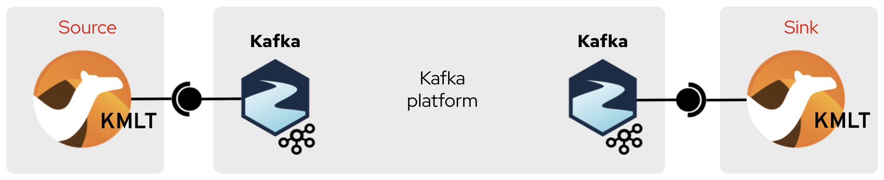







Camel Pipes
ENTERPRISE INTEGRATION
bind Kamelets to form a running integration unit
Kafka app
Kafka app
Kafka
client
Kafka
client
Notes:
(Same slide but using AMQ-Streams platform)
This example shows the same any-to-any Kamelet Bindings (as seen in the KB intro slides) but with the AMQ-Streams platform in between.
We can channel any input data source into AMQ-Streams. Any client or application connected to AMQ-Streams is a potential consumer
Likewise we can export any AMQ-Streams events to the outside world via Sink Kamelets and thus, any Kafka client or application connected to AMQ-Streams becomes a potential data producer to external entities.

Slide 31
Enterprise Integration Patterns

Slide 32
Efficiently connect disparate systems
using integration patterns
Message Bridge
Data Pipeline
Service Mediator
Routing
Data migration
Routing
Publish-subscribe
Data enrichment
Composition
Message transformation
Data synchronization / Strangler
Orchestration
Exactly once delivery
Aggregation
Parallel pipeline
Event sequencing
Claim check
Error handling
Batch processing
Correlation
Correlation
Dead letter queue
Retry
Retry
Correlation
Normalizer
Throttling
Idempotence resolution
Interface translation
Event sourcing
Health check
Solution implementation
Load leveling
Enterprise Integration Patterns
Saga
Notes:
Use of integration patterns leads to efficient solution implementation of connecting disparate systems

Slide 33

System Integration
System A
System B

Slide 34
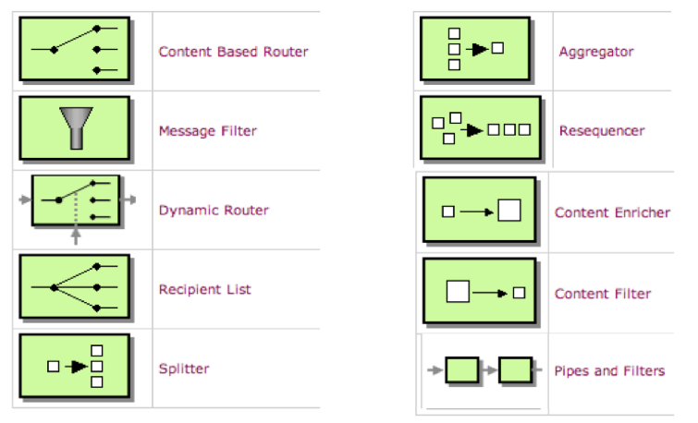
Enterprise Integration Patterns
Notes:
Universal patterns that are reusable for developers to use

Slide 35

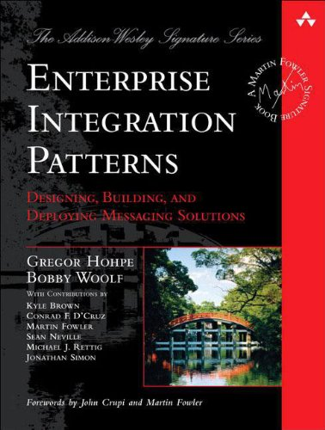




Integration Patterns
Electronics
Split
orders
Send
each order
to it’s
process service
Others
Aggregator
Content Enricher
Normalizer
Resequencer

Slide 36
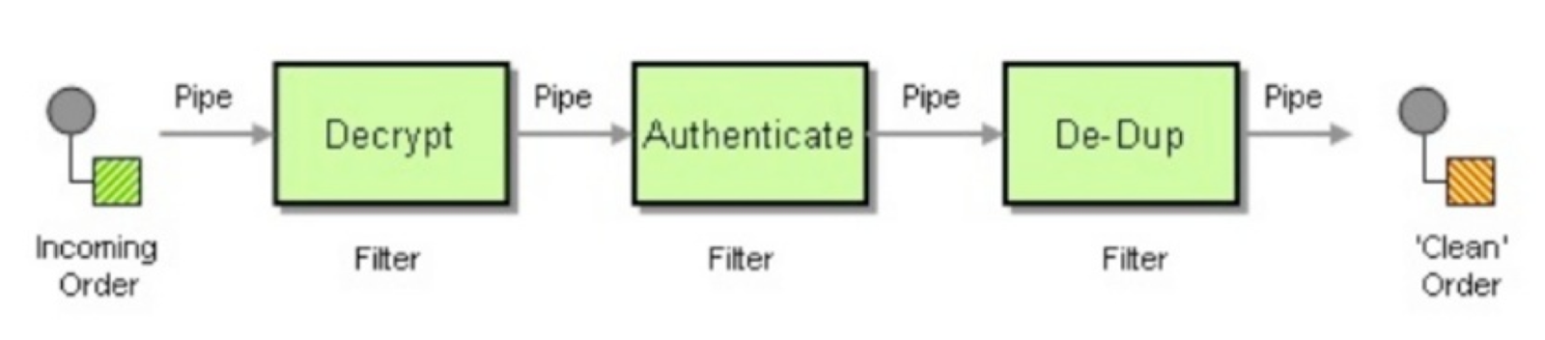
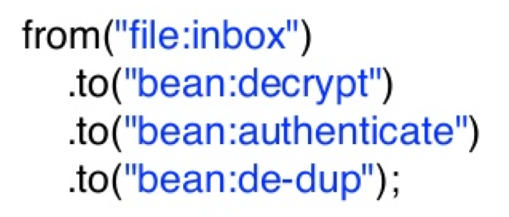
Happy Path Scenarios
How Pipes and Filters Pattern looks in Camel?
Notes:
So, let's start with some of the easy use cases and patterns.
Camel is based on Pipes and Filters pattern,
Pipes and Filters architectural style to divides a larger processing task into a sequence of smaller, independent processing steps (Filters) that are connected by channels (Pipes).
So is Camel… camel moves messages from souce to destination by performing routing and transformation at every step which are connected by pipes
But even then, there is the question, how do we start… and this where the first pattern comes into play.

Slide 37
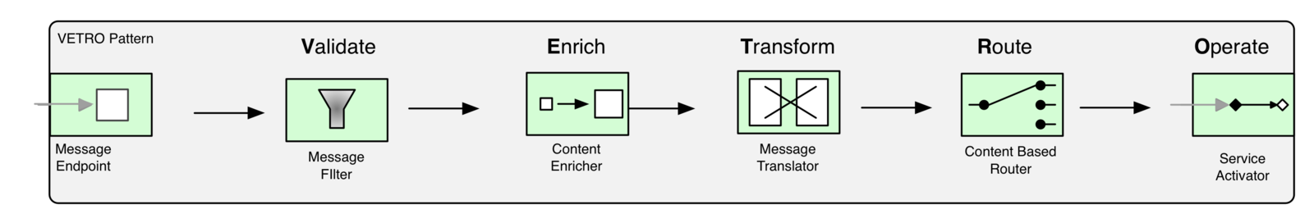
VETRO
What is a typical processing flow for a Camel route?
Validate: validation, schematron, MSV, Jing, bean validation components
Enrich: enrich and pollEnrich EIPs, custom beans
Transform: Data formats, auto type conversion, templating components
Route: Message routing EIPs
Operate: this is the essence of the processing flow
Notes:
VETRO is a nice acronym and pattern to keep in mind and start with when creating a Camel route...

Slide 38
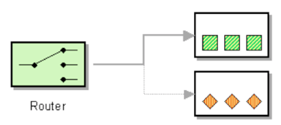
Camel Routes
from("file:data/inbox")
.to("jms:queue:order");
Java DSL
<route>
<from uri="file:data/inbox"/>
<to uri="jms:queue:order"/>
</route>
XML DSL
Notes:
Very simple Camel route example

Slide 39
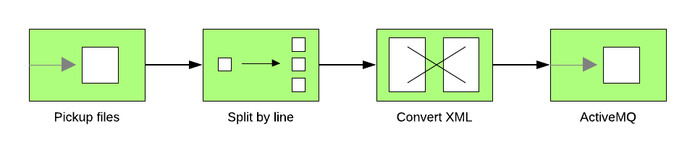
from("file:inbox")
.split(body().tokenize("\n"))
.marshal(customToXml)
.to("activemq:queue:line");

Slide 40
CAMEL EXCHANGE
Exchange
Header
Key:Value
Key:Value
Key:Value
IN Message
Out Message
Header
Header
Key:Value
Key:Value
Arbitrary type
Key:Value
Key:Value
Key:Value
Key:Value
Body
Body
Attachment
Attachment
Attachment
Attachment
Attachment
Attachment
arbitrary MIME types

Slide 41
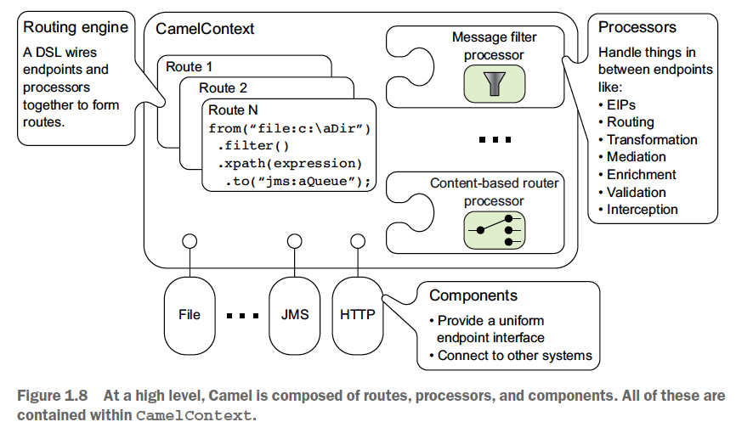
Camel Architecture
Notes:
Overall architecture of Apache Camel

Slide 42
DATA FORMAT EXAMPLE
Input XML File:
<root> <child1>text1</child1>
<child2>text2</child2>
</root>
Output JSON File:
{"root":
{"child1": "text1",
"child2": "text2"}
}
Camel Route:
...
from(“file:///xmlsourcedir”)
.unmarshal().jaxb()
.process(...)
.marshal().json()
.to(“file:///jsondestdir”);
...

Slide 43
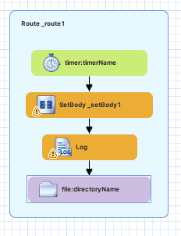
Camel Route
Consumer
Consume requests
Start of a route
Dispatching outgoing replies
Processor
Intermediate node in the pipeline
standard processors or customized ones
Producer
Produce requests
End of route
Dispatching outgoing requests

Slide 44
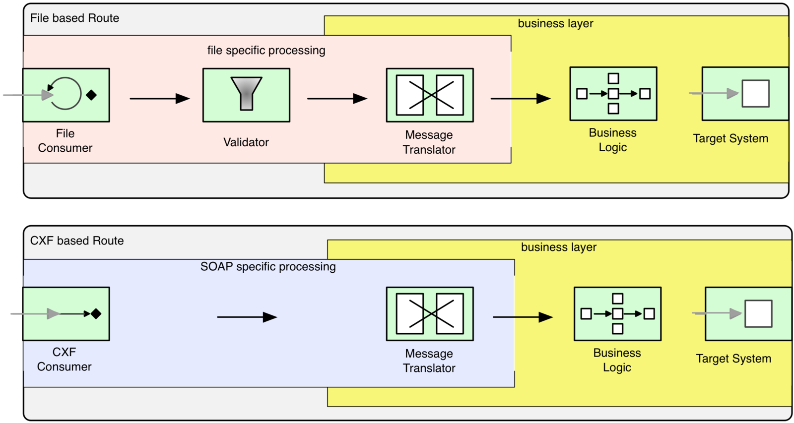
Edge Component
How to expose the same business functionality to multiple consumers?
Notes:
The
Edge Component pattern is a design pattern for Apache Camel that separates the business logic of an integration from the technology-specific details of the endpoints it connects to. It is a specialization of the Ports and Adapters (or Hexagonal Architecture) pattern, applied within a Camel-based application.
This approach divides your Camel routes into two distinct layers:
The "Inside" Layer (Core Logic): Contains reusable Camel routes that focus solely on the business logic of the integration. This layer is independent of any specific protocol or transport technology.
The "Outside" Layer (Edge Components/Adapters): Contains Camel routes that act as adapters, handling the specifics of a particular technology or protocol. This includes dealing with message formats, security, transactionality, and error handling for a given endpoint.
How the pattern works
The Edge Component pattern uses Camel's internal communication components—such as direct, seda, and vm—to create the connection between the two layers. These components allow you to call one route from another, passing messages in memory.
A typical implementation would look like this:
Incoming Message: A route in the "outside" layer listens for incoming messages from a specific technology, like a file system or a REST endpoint.
Protocol-Specific Handling: The route performs any necessary technology-specific logic, such as authentication, protocol-specific error handling, or message format conversion.
Transfer to Core: The message is then passed to the "inside" layer using a direct: or seda: component.
Business Logic: The route in the "inside" layer, which is completely decoupled from the original protocol, processes the business logic.
Outgoing Message: After the business logic is complete, the message is passed back out to another "edge" component, which handles the technology-specific details of the response, such as sending an email or updating a database.
Key benefits
Decoupling: The separation of concerns makes your integration logic cleaner and more maintainable. The core business logic can be tested and reused independently of its transport mechanism.
Reusability: The "inside" routes can be reused by multiple different "edge" components. For example, the same core processing route could be invoked by an FTP component, a JMS component, or a REST component.
Flexibility: It becomes much easier to switch technologies without rewriting your core business logic. If you need to change from a JMS queue to a Kafka topic, you only need to change the corresponding "edge" component.
Improved Testability: By isolating the business logic, you can write unit tests for your core routes without needing to spin up a file server, JMS broker, or other complex services.
Example scenario
Imagine an order processing application:
"Outside" Layer:
FileOrderComponent: A route that consumes an XML file from a file system and parses it.
JmsOrderComponent: A route that consumes an order message from a JMS queue.
Internal Call: Both the FileOrderComponent and JmsOrderComponent routes call the direct:processOrder endpoint after their initial processing.
"Inside" Layer:
processOrderRoute: A core route that listens on direct:processOrder. It contains the business logic for validating and enriching the order data.
Outgoing "Outside" Layer:
DatabaseComponent: An edge component route that receives the enriched message from the core and persists it in a database.

Slide 45
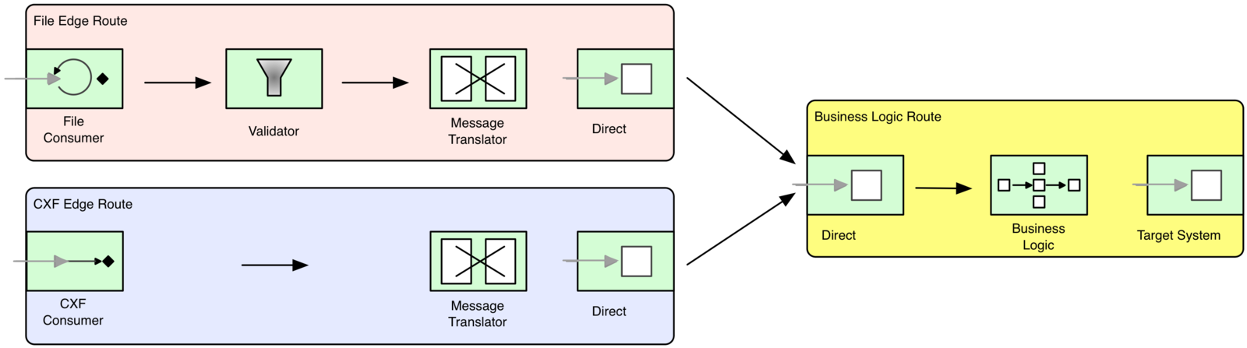
Edge Component
Encapsulate endpoint-specific details and prevent them from leaking into the business logic of an integration flow.
Notes:
The solution for the above scenario is to apply the “Separation of Concerns Principle”, or the “Single Responsibility Principle”,
That is to encapsulate endpoint specific processing logic into its own layer and don't allow it to leak into the reusable business layer.

Slide 46
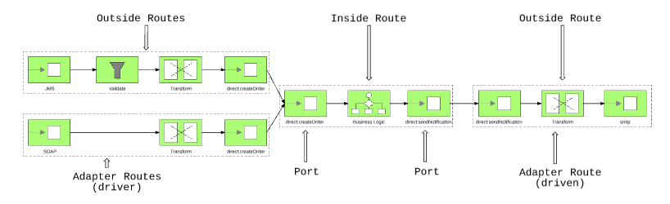
Hexagonal Architecture with Camel
Hexagonal Architecture as a Natural fit for Camel
Notes:
The Service Instance Pattern [SOA PATTERNS] is the result of applying horizontal scaling principles to the application layer.
The main benefit of stateless services is that they are easier to load balance and fail over through the Service Instance Pattern. If the throughput of a service is not high enough, it is easy to start more instances and scale linearly. If a service fails, it is easy to start another instance or fail over to other running service instances.

Slide 47
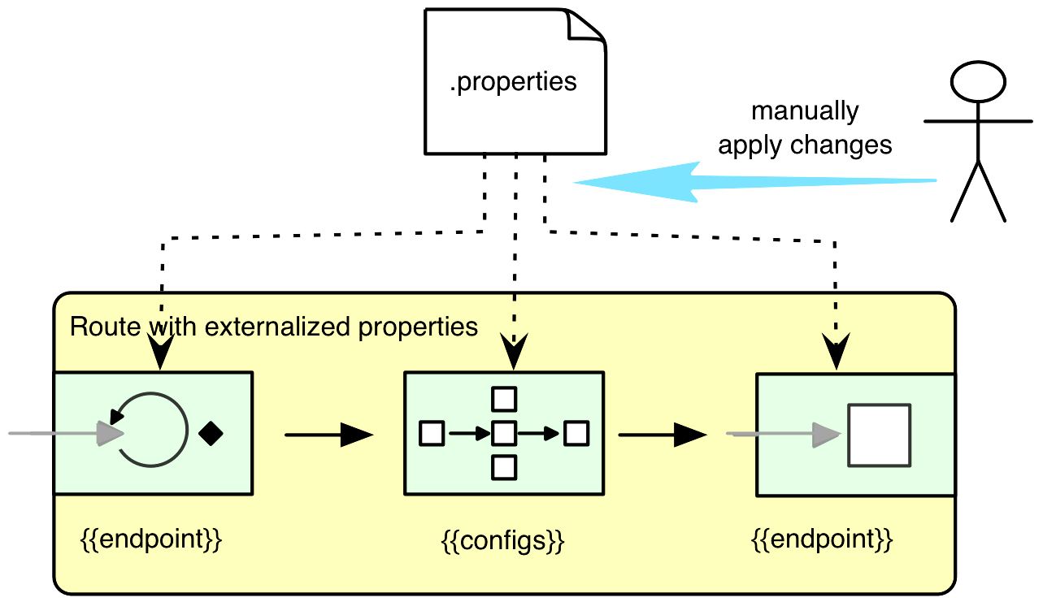
Runtime Reconfiguration
How to change behavior of the application without redeploying or restarting it?
Notes:
This is also known as the Runtime Variability Pattern.
The key for a runtime variability of behaviour is to encapsulate and externalize the varying behaviours from the main processing flow through an extension point. This allows the processing flow and the dynamic behaviour to have independent life cycles and interact through this extension point.
Properties
JMX
Jolokia
Hawtio

Slide 48
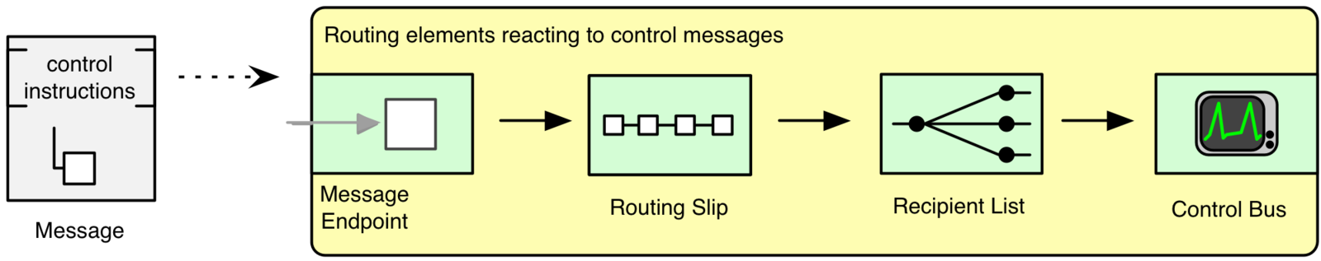
Runtime Reconfiguration
Message-Driven variability passes control instructions together with the input data.
Routing Slip EIP
Recipient List EIP
Control Bus EIP

Slide 49
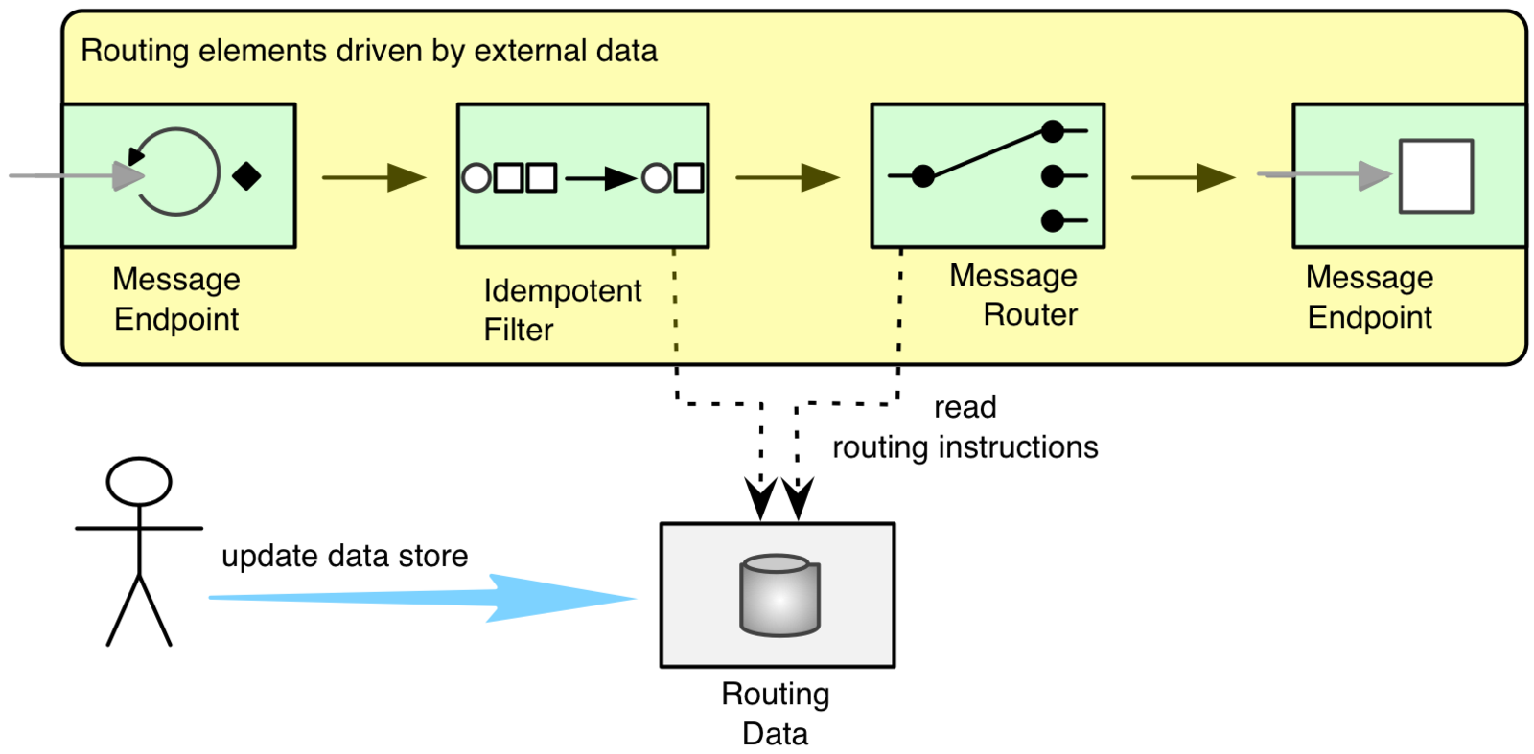
Runtime Reconfiguration
External data driven route configuration.

Slide 50
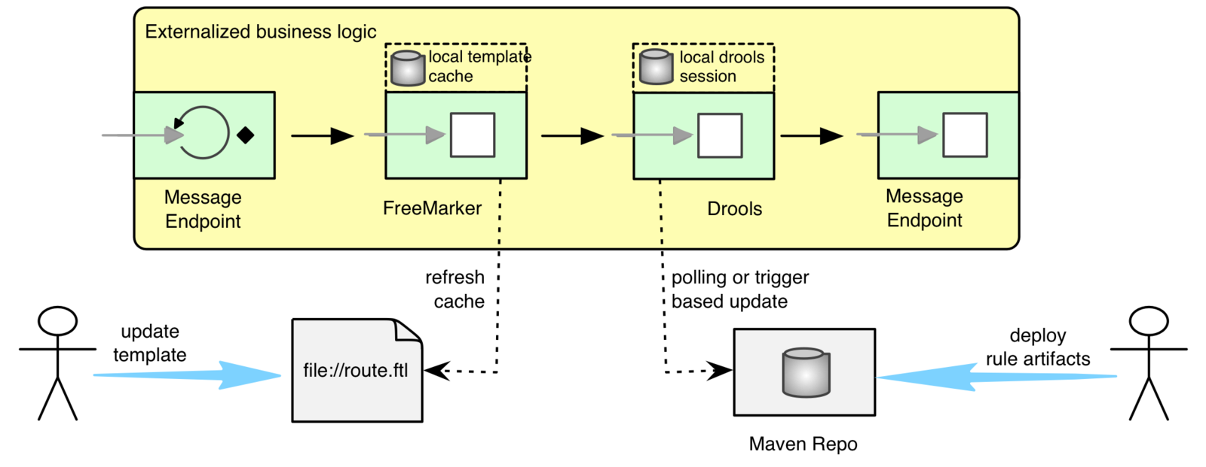
Runtime Reconfiguration
Business logic variability
Camel Drools component: push or pull model example
Templating engines: FreeMarker, JTE, Mustache, String Template, Thymeleaf, and Velocity
Scripting engines: Simple, Groovy, JavaScript, Java
Notes:
Templating engines:
A template engine is a tool that generates text output, such as emails, XML, or code, by combining templates with dynamic data. In Apache Camel, templates are primarily used to create layouts while dynamically using exchange data.
Scripting engines:
Simple: Camel's own built-in, lightweight expression language, which is well-suited for common routing tasks. It supports basic expression evaluation without extra dependencies.
Groovy: This is a powerful, dynamic language that you can use for more complex scripting within your routes. To use it, you need to add the camel-groovy dependency.
JavaScript: You can execute JavaScript code within a route to define dynamic logic. It requires the camel-js dependency and is available as a DSL in some versions.
Java: Using the camel-joor dependency, Camel can compile and execute Java code at runtime for expressions.
Scripting engines are central to implementing advanced Enterprise Integration Patterns (EIPs) that require dynamic routing logic.
Language Component: The language component allows you to send an Exchange to an endpoint that executes a script written in any of Camel's supported languages. The script itself can be specified dynamically using expressions. The URI format is language://languageName[:script].
Dynamic Router EIP: The Dynamic Router EIP uses a scripting engine to determine the next endpoint for a message at runtime.
For example, you can annotate a Java bean method with @DynamicRouter and use an expression language like XPath to make a routing decision based on the message content.
Recipient List EIP: A variation of the Dynamic Router, the Recipient List also uses expressions to generate a list of endpoint URIs where the message should be sent.
toD Endpoint: The "to dynamic" (toD) EIP can use a simple expression or other scripting language to construct an endpoint URI at runtime, allowing for highly flexible routing.

Slide 51
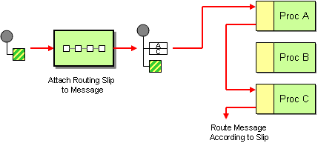
Routing Slip
Enable messages to be routed consecutively through a series of processing steps, where the sequence of these steps is not known at design time and can vary for each individual message
Notes:
How it works:
Attach a Routing Slip: A "routing slip" is attached to each message, which explicitly specifies the sequence of processing steps (endpoints) the message should follow. This slip is typically stored in a message header.
Special Message Router: A special message router component in Camel reads this routing slip.
Sequential Routing: The router then directs the message to the first endpoint specified in the slip. After processing at that endpoint, the message is then automatically routed to the next endpoint in the slip, and so on, until all endpoints in the slip have been visited.
Key characteristics:
Dynamic Sequencing:
The order of processing steps can be determined dynamically at runtime based on message content or other criteria, rather than being fixed in the route definition.
Sequential Processing:
Unlike the Recipient List pattern where a message is sent to multiple destinations simultaneously, the Routing Slip ensures that the message flows through the specified endpoints one after another.
Output as Input:
The output of one processing step effectively becomes the input for the subsequent step in the routing slip.
Implementation in Apache Camel:
You can implement the Routing Slip EIP in Apache Camel using various methods:
Using a Bean: A Java bean can be used to compute the routing slip header dynamically based on the message content or other factors.
Using an Expression: Camel expressions can be used to generate the routing slip dynamically.
Using the @RoutingSlip Annotation: In a POJO (Plain Old Java Object) method, the @RoutingSlip annotation can be used to define a method that returns the routing slip.

Slide 52
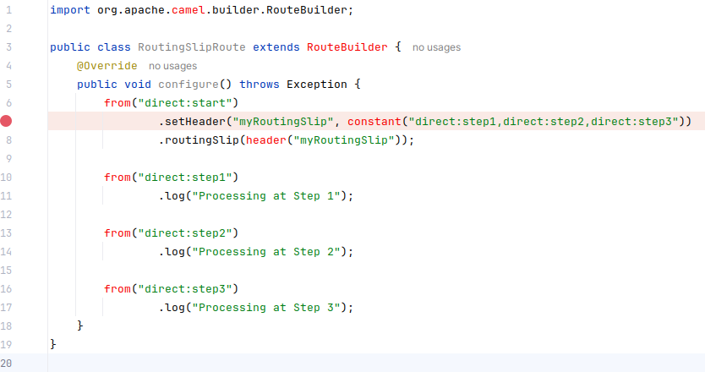
Routing Slip
Enable messages to be routed consecutively through a series of processing steps, where the sequence of these steps is not known at design time and can vary for each individual message
Notes:
In this example, the direct:start route sets a header named myRoutingSlip with a comma-separated list of endpoints. The routingSlip(header("myRoutingSlip")) then instructs Camel to route the message sequentially through direct:step1, direct:step2, and direct:step3.

Slide 53
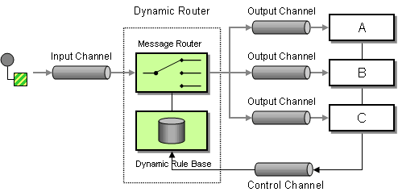
Dynamic Router
Dynamic routing of messages through a sequence of processing steps, where the next step is determined at runtime based on an expression
Notes:
Unlike the standard Routing Slip, which is evaluated only once, the Dynamic Router continuously re-evaluates the routing slip on-the-fly to determine the subsequent destinationv
Dynamic Routing Slip:
The core of the Dynamic Router is a dynamic routing slip, which is an expression that provides the endpoint URI(s) for the next processing step. This expression is re-evaluated after each step.
Expression-based:
The dynamic routing slip can be computed using various expressions, such as methods on a bean, simple expressions, or other Camel expression languages.
Continuation and Termination:
The routing continues as long as the expression returns a non-null value (indicating the next endpoint). When the expression returns null, the dynamic routing sequence terminates.
Flexibility:
This pattern provides significant flexibility, allowing the routing logic to adapt to changing conditions or external configurations without requiring code modifications.
Use Cases:
It is particularly useful for scenarios involving conditional routing, content-based routing, load balancing, or implementing a process manager where the sequence of steps is not fixed at design time.
Important considerations:
Ensure the expression used for the dynamic router eventually returns null to prevent infinite loops.
Be mindful of thread safety if the bean or logic used to compute the slip maintains state.
Consider the potential overhead of creating numerous dynamic endpoints if the expression generates a wide variety of unique endpoint URIs. The toD EIP, for instance, offers caching mechanisms to mitigate this.

Slide 54
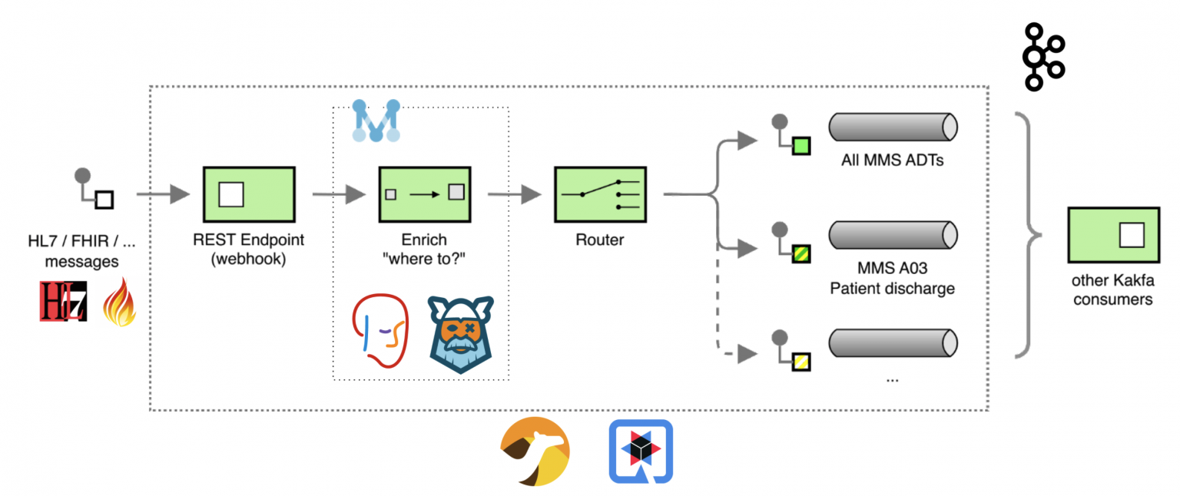
Content Based Routing Kafka
Hexagonal Architecture as a Natural fit for Camel
Notes:
how to implement a complete, end-to-end Content Based Routing solution using Apache Camel, AtlasMap and Quarkus as a developer platform, including: Drools DMN Engine, Kogito. Apache Kafka is used in this solution as a message broker. Content based routing overview Here is the Enterprise Integration Pattern (EIP) diagram of the flow, annotated with some details of the components used: The focus of this solution is routing healthcare-related messages; for this demo example, messages are routed accordingly to the following decision table rules:

Slide 55
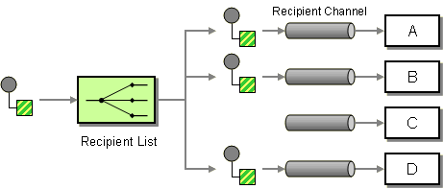
Recipient List
Allow a message to be routed to a dynamically determined list of endpoints
Notes:
This means the destinations for a message are not fixed in the route definition but are instead evaluated at runtime, often based on the message content or headers.
Key characteristics and features of the Recipient List EIP:
Dynamic Routing:
The primary purpose is to send the same message to multiple, dynamically determined recipients.
Recipient Determination:
The list of recipients can be specified using various expressions, such as:
Header values: Extracting a comma-separated string of endpoint URIs from a message header.
Expression languages: Using Camel Simple, XPath, Groovy, or other expression languages to compute the recipient list.
Processing Modes:
Sequential (default): Messages are sent to recipients one after another.
Parallel: Messages are sent to recipients concurrently, which can improve performance for independent processing.
Aggregation (Optional):
When using parallel processing or if replies are expected, an AggregationStrategy can be defined to combine the responses from multiple recipients into a single outgoing message.
Error Handling:
Options like ignoreInvalidEndpoints allow for graceful handling of situations where a dynamically determined endpoint URI is invalid or unavailable.
Configuration:
The Recipient List EIP can be configured in various ways within Camel routes, including using Java DSL or XML DSL.

Slide 56
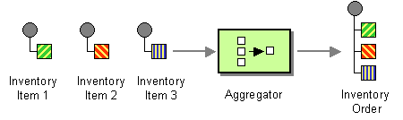
Aggregate
Combine multiple related messages into a single, cohesive message
Notes:
This pattern is particularly useful in scenarios where you need to collect and process information from various sources or consolidate fragmented data before further processing.
how it works:
Correlation Expression:
This expression defines how messages are grouped together. It's evaluated on each incoming message to produce a "correlation key." Messages with the same correlation key are then aggregated into the same batch. For instance, you might use a customer ID from the message header or body as the correlation key to aggregate all orders from a specific customer.
Completion Condition:
This determines when a batch of messages is considered complete and ready for release. You can specify a simple size limit (e.g., aggregate 10 messages), a timeout (e.g., release messages after 5 seconds), or a more complex predicate condition that evaluates message content to determine completeness (e.g., release when a specific "end of batch" message arrives).
Aggregation Strategy:
This is a crucial component that defines how the individual messages within a correlated batch are combined into a single outgoing message. You implement the AggregationStrategy interface, providing logic to merge the incoming exchanges into a single result exchange. This could involve combining message bodies, headers, or other relevant data.

Slide 57
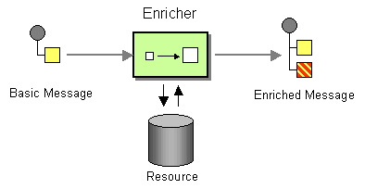
Content Enricher, Poll Enrich and Poll
Augment an incoming message with additional data from an external source
Notes:
This is particularly useful when the initial message lacks certain information required for further processing, and this missing data can be retrieved from another system or resource.
How it works:
Incoming Message:
A message enters a Camel route, containing some initial data.
Enrichment Request:
The Content Enricher component sends a request to an external resource (e.g., a database, a web service, another Camel endpoint) to retrieve the missing information.
Resource Exchange:
The external resource provides the requested data, which forms a "resource exchange."
Aggregation:
An AggregationStrategy is used to combine the original incoming message (from the "original exchange") with the data obtained from the external resource (from the "resource exchange"). This strategy defines how the two pieces of information are merged into a single, enriched message.
Enriched Message:
The resulting enriched message, now containing all necessary data, continues its journey through the Camel route.

Slide 58
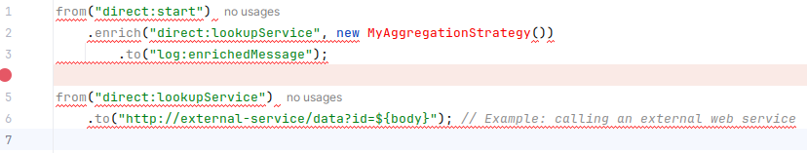
Content Enricher, Poll Enrich and Poll
Augment an incoming message with additional data from an external source
enrich EIP:
This is the most common way to implement the Content Enricher. It uses a Producer to obtain the data, typically for request-reply messaging (e.g., invoking a web service).
pollEnrich EIP:
This variant uses a Polling Consumer to obtain the additional data, often used for event message messaging (e.g., reading a file, downloading via FTP).
AggregationStrategy:
This is a crucial interface you implement to define the logic for combining the original exchange and the resource exchange. You specify how the data from both sources should be merged into a single, enriched message body or headers.
Notes:
In this example:
An incoming message to direct:start is enriched.
The enrich EIP calls direct:lookupService to get additional data.
direct:lookupService then calls an external HTTP service, using the body of the original message as an ID in the URL.
MyAggregationStrategy (your custom implementation) combines the original message and the response from the HTTP service.
The enriched message is then logged.

Slide 59
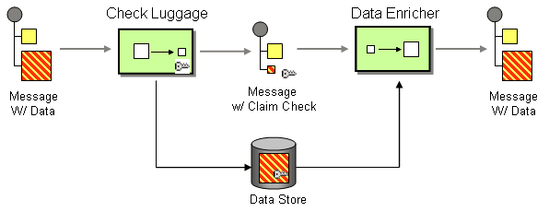
Claim Check
Replace large message content with a unique identifier (the “claim check” or “key”)
Notes:
The "claim check" or "key" points to the message's location in temporary storage, such as a database or file system. This makes messages smaller and more efficient to transmit, with the original content retrieved from storage later using the key via get operations on the Claim Check EIP.
How it Works
1. Producer Action:
A message producer encounters a large payload. Instead of sending the full content, it stores the large content in a temporary store (like a database, Hazelcast, or even a file system) and generates a unique key.
2. Message Content Update:
The producer then replaces the original large message content with this unique key (the claim check).
3. Message Transmission:
This smaller message, containing only the identifier, is then sent through the messaging system.
4. Consumer Action:
A consumer that receives the message can use the claim check to retrieve the original, large message content from the temporary store. This is done using a get or get and remove operation on the Claim Check EIP.
Why Use It
Efficiency for Large Payloads: .
By not including massive data directly in messages, the pattern significantly reduces message size, making transmission and processing more efficient and less resource-intensive.
Sensitive Data Protection: .
It allows sensitive or private information to be stored separately and only be made accessible to trusted parties who have the claim check.
Handling Unreliable External Systems: .
It provides a way to process data that cannot be directly sent to a third-party system, by storing the data and giving the third party a reference to retrieve it later.
In Apache Camel
The Claim Check EIP (Enterprise Integration Pattern) directly supports this pattern.
You can use it with operations like set to store a new claim check (replacing the message with the key) and get or get and remove to retrieve the original message content.
Camel's implementation can temporarily store message content in its internal memory store or a user-provided external store, such as a database or a cache like Hazelcast.

Slide 60
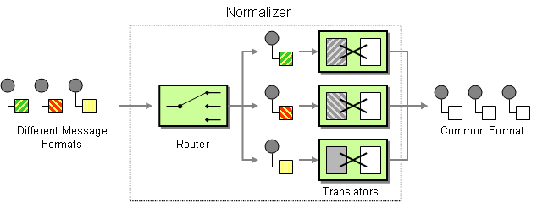
Normalizer
Take incoming messages that represent the same data but in different formats and transform them into a common, standardized format
Notes:
It achieves this by using a Content-Based Router to detect the format of each incoming message and then directing it to the appropriate Message Translator for conversion into the single, common format.
How it Works
Message Detection:
A Content-Based Router examines an incoming message to determine its format (e.g., XML, JSON, CSV).
Routing to Translator:
Based on the detected format, the router directs the message to a specific Message Translator.
Transformation:
The chosen Message Translator converts the message from its original format into a canonical, or common, format.
Common Format:
All messages are processed in this single, standardized format, allowing for consistent handling downstream.

Slide 61
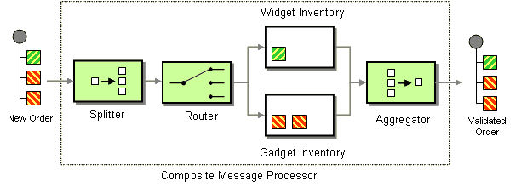
Composed Message Processor
Handle messages that are composed of multiple sub-messages
Notes:
It allows for the processing of a composite message by:
Splitting: the main message into individual sub-messages.
Routing: each sub-message to its appropriate destination or processor for individual handling.
Aggregating: the responses or results from the processing of the sub-messages back into a single, unified message.
Implementation in Apache Camel:
Camel primarily implements the Composed Message Processor pattern using the Splitter EIP, which has built-in aggregation capabilities.
Splitter:
The splitter EIP breaks down a message into smaller, individual messages based on a defined expression (e.g., a collection in the message body). Each split message is then processed independently.
Aggregation:
After individual processing, the results of these sub-messages are often re-aggregated back into a single message using an aggregationStrategy. This strategy defines how the individual responses are combined.
Example Scenario:
Consider an order processing system where a single order message contains multiple order items. The Composed Message Processor pattern can be applied as follows:
Split: The incoming order message is split into individual order item messages.
Route: Each order item message is routed to a specific inventory service (e.g., widget inventory, gadget inventory) for stock availability checks.
Aggregate: The results from each inventory check are then aggregated back into a single order status message, indicating whether the entire order can be fulfilled.
While the Splitter with its built-in aggregation is the primary mechanism, the Aggregator EIP can also be used in conjunction with the Splitter for more advanced aggregation scenarios, especially when grouping into multiple aggregation groups is required.

Slide 62
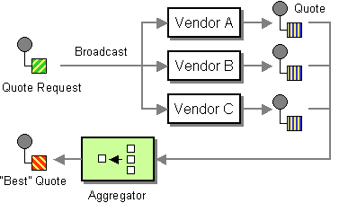
Scatter-Gather
Send a message to multiple recipients and then re-aggregate their responses into a single message
Notes:
It is often implemented using a combination of the Recipient List and Aggregator EIPs. This pattern is ideal for scenarios like finding the best price from several vendors or collecting data from different backend systems to present a consolidated view.
Recipient List: This component sends the original message to a dynamically generated list of endpoints. The list can be constructed from a message header or from other dynamic sources.
Aggregator: This component collects the individual responses from each recipient. It uses a CorrelationExpression to link the responses to the original request and a custom AggregationStrategy to merge the multiple responses into a single message.
Aggregation Strategy: This is a custom Java class that defines the logic for how responses are combined. For example, it might select the best price, sum up numerical values, or combine data from different sources into a single object.
Modes of operation
Camel supports the scatter-gather EIP in two primary modes:
Request/Reply Mode (Synchronous): The aggregated response is sent back to the original message sender.
One-Way Mode (Asynchronous): The responses are aggregated separately, allowing the main message thread to continue without waiting for a reply.

Slide 63
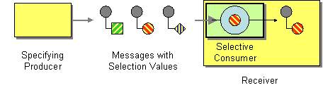
Selective Consumer
Filter messages before a consumer processes them
Notes:
It ensures that a consumer only receives and processes messages that match a specific set of criteria. This is particularly useful for decoupling message consumers from the message provider, allowing consumers to express interest only in certain types of messages.
Key benefits of the selective consumer pattern
Decoupling: Consumers don't need to know how or why messages are filtered, only that they will receive the ones they want.
Performance: When filtering is done at the message broker level (like with JMS selectors), it reduces network traffic and processing load on the consumer.
Flexibility: It's easy to add new consumers for different types of messages without altering the producers or the underlying messaging infrastructure.
Key benefits of the selective consumer pattern
Decoupling: Consumers don't need to know how or why messages are filtered, only that they will receive the ones they want.
Performance: When filtering is done at the message broker level (like with JMS selectors), it reduces network traffic and processing load on the consumer.
Flexibility: It's easy to add new consumers for different types of messages without altering the producers or the underlying messaging infrastructure.

Slide 64
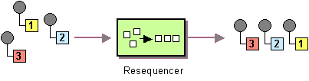
Resequence
Collect messages from an input channel and reorder them based on a defined criterion
Notes:
e.g., a sequence number in a header or message body), and then delivers them to an output channel in the correct, sequential order. This is crucial in scenarios where message delivery order is not guaranteed by the messaging system, but the application requires ordered processing.
Configuration Options:
Both batch and stream resequencers offer various configuration options to fine-tune their behavior, such as:
Capacity: The size of the internal queue for holding out-of-sequence messages.
Timeout: The maximum time to wait for missing messages or to form a batch.
Comparator: A custom comparator can be provided for more complex resequencing logic.
Ignore Invalid Exchanges: Whether to ignore or throw an exception for messages that cannot be resequenced.
Key Benefits:
Ensures ordered message processing in distributed systems.
Handles out-of-order message delivery gracefully.
Provides flexibility with batch and stream resequencing modes.
Integrates seamlessly with other Apache Camel EIPs and components.

Slide 65

Resequence
Collect messages from an input channel and reorder them based on a defined criterion
Batch Resequencing
Stream Resequencing
Messages are collected into a batch, either by reaching a maximum number of messages or by a timeout period.
Once a batch is formed, the messages within that batch are sorted according to the resequencing expression and then delivered.
This mode is suitable when a complete set of messages needs to be available before resequencing and processing can begin.
Messages are delivered as soon as possible, as long as the next expected sequence number arrives.
This mode is designed for scenarios where messages can be reordered based on simple, sequential values (e.g., integers like 1, 2, 3...).
It aims to minimize latency by delivering messages as soon as their correct position in the sequence is determined.
Notes:
e.g., a sequence number in a header or message body), and then delivers them to an output channel in the correct, sequential order. This is crucial in scenarios where message delivery order is not guaranteed by the messaging system, but the application requires ordered processing.
Configuration Options:
Both batch and stream resequencers offer various configuration options to fine-tune their behavior, such as:
Capacity: The size of the internal queue for holding out-of-sequence messages.
Timeout: The maximum time to wait for missing messages or to form a batch.
Comparator: A custom comparator can be provided for more complex resequencing logic.
Ignore Invalid Exchanges: Whether to ignore or throw an exception for messages that cannot be resequenced.
Key Benefits:
Ensures ordered message processing in distributed systems.
Handles out-of-order message delivery gracefully.
Provides flexibility with batch and stream resequencing modes.
Integrates seamlessly with other Apache Camel EIPs and components.

Slide 66

Unhappy Path Scenarios
Happy paths are the easy ones. More work is required for designing and implementing the unhappy paths.
Data Integrity Pattern
Saga Pattern
Retry Pattern
Idempotent Filter Pattern
Circuit Breaker Pattern
Error Channels Pattern
Throttling Pattern

Slide 67
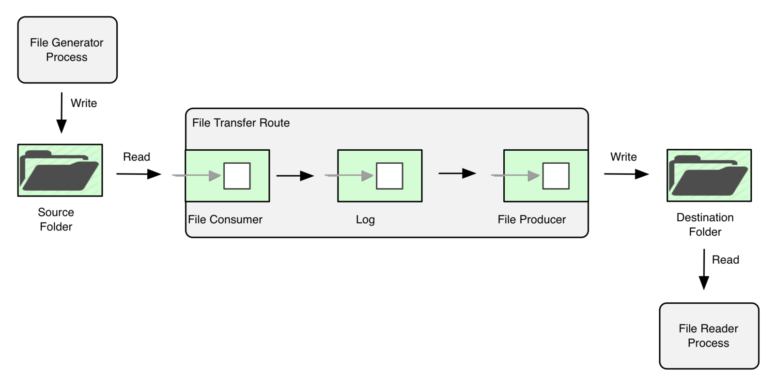
Data Integrity
How hard can it be to copy files from one location to another?

Slide 68
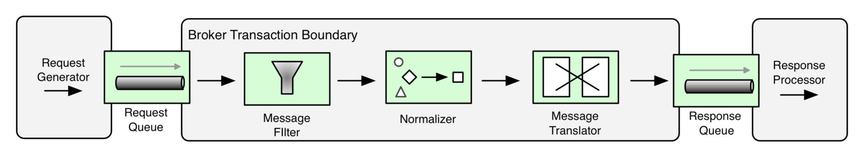
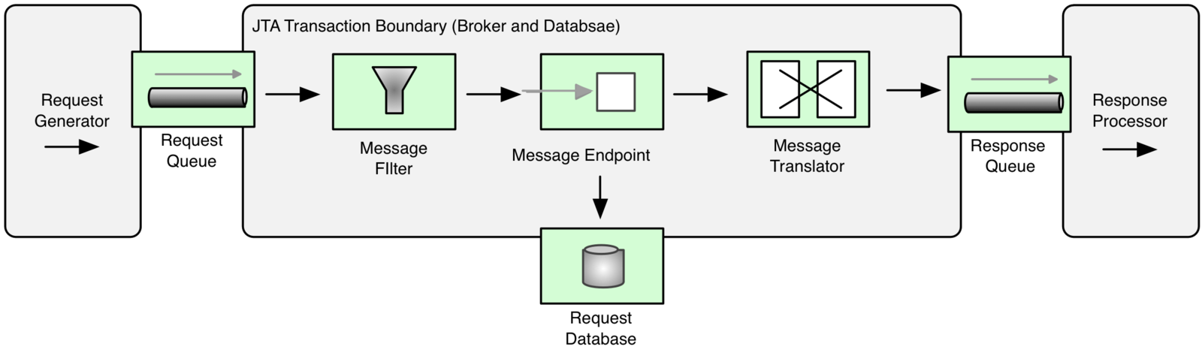
Data Integrity
Transactional systems
Local transaction manager
Global transaction manager
Notes:
It is crucial to understand that a given transaction is associated with only the current thread. You must not create a thread pool in the middle of a transactional route because the processing in the new threads will not participate in the current transaction.
If you want to break a route into fragments and have each route fragment participate in the current transaction, you can use direct: endpoints.

Slide 69
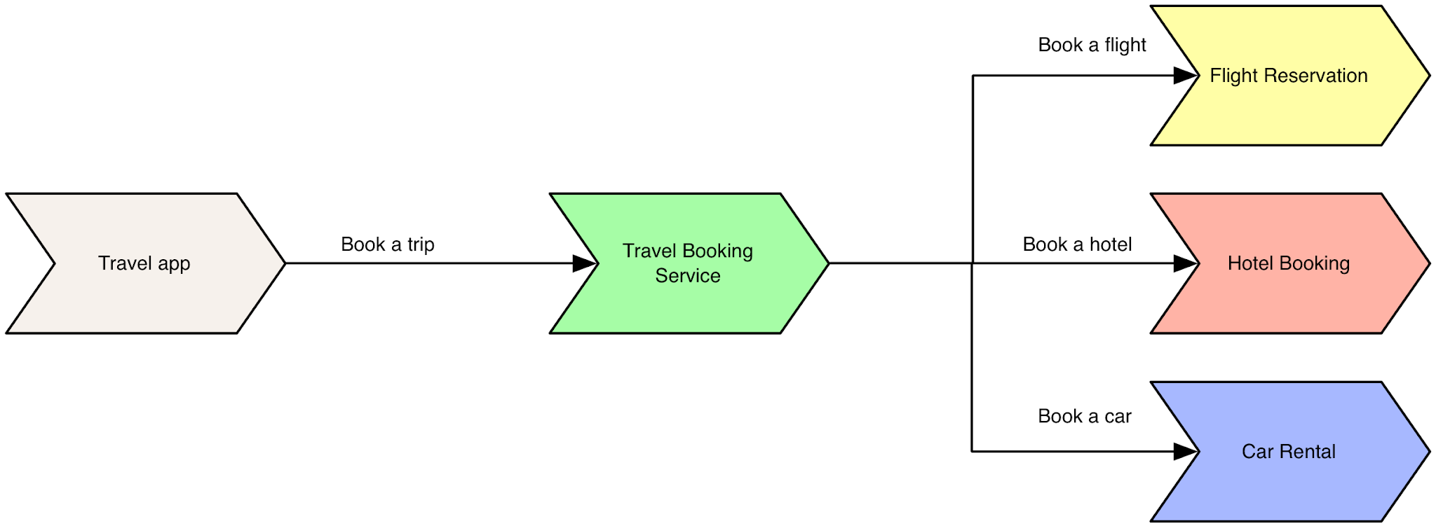
Saga
How to avoid distributed transactions and ensure data consistency?

Slide 70
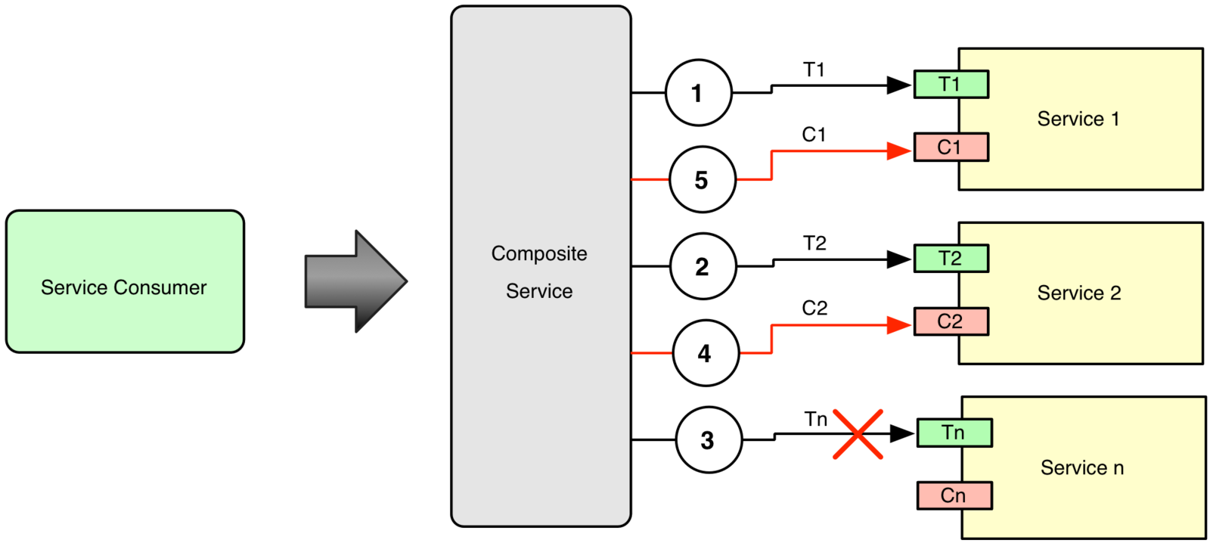
Saga
Ensures that each step of the business process has a compensating action to undo the work completed in the case of partial failures.

Slide 71
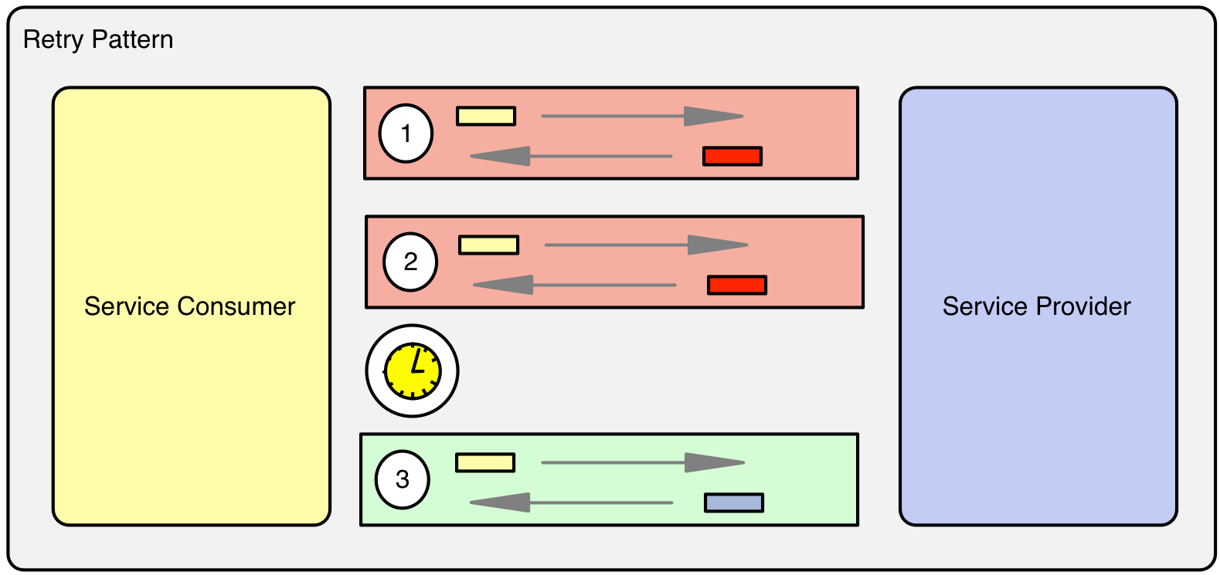
Retry
To enable applications handle anticipated transient failures by transparently retrying a failed operation with expectation it to be successful.
Which failures to retry?
How often to retry?
Idempotency
Monitoring
Timeouts and SLAs
Notes:
By their very nature integration applications have to interact with other systems over the network. With dynamic cloud-based environments becoming the norm, and the microservices architectural style partitioning applications into more granular services, the successful service communication has become a fundamental prerequisite for many distributed applications. Services that communicate with other services must be able to handle transient failures that can occur in downstream systems transparently, and continue operating without any disruption. As a transient failure can be considered an infrastructure-level fault, a loss of network connectivity, timeouts and throttling applied by busy services, etc. These conditions occur infrequently and they are typically self- correcting, and usually retrying an operation succeeds.

Slide 72
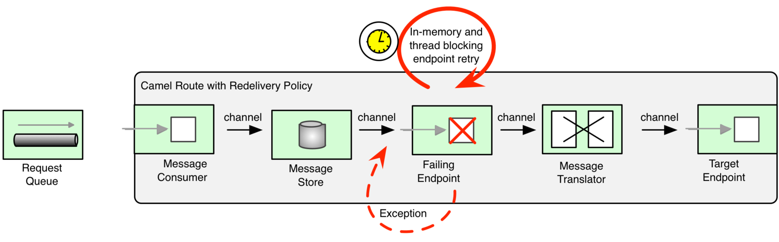
Retry
Camel RedeliveryPolicy
The most well known retry mechanism in Camel
Retries only the failing endpoint
Fully in-memory
Thread blocking behavior by default
Can be asynchronous
Good for small number of quick retries (in milliseconds)

Slide 73
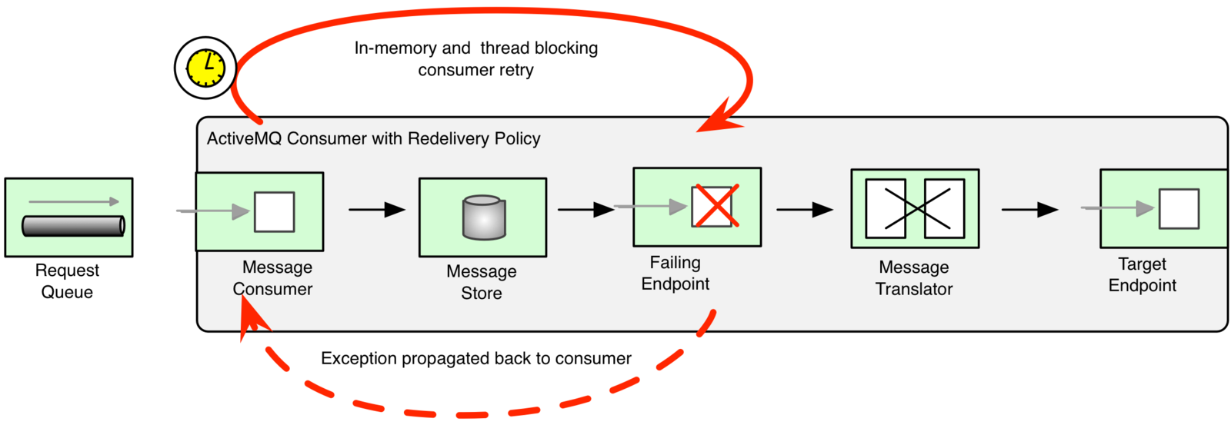
Retry
ActiveMQ consumer RedeliveryPolicy
Retries the message from the beginning of the Camel route
Not used very often, but enabled by default
Fully in-memory
Thread blocking by default
Good for small number of quick retries (in milliseconds)

Slide 74
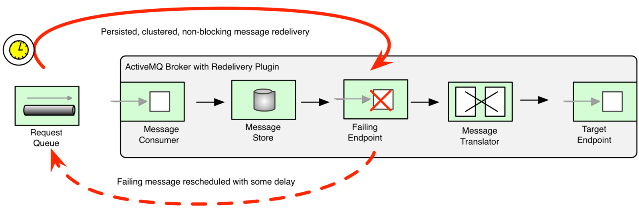
Retry
ActiveMQ Broker Redelivery
ActiveMQ specific and requires custom logic
It will consume the message again from a queue
Persisted at the broker rather than application memory
Can be clustered and use fail over, load balancing, etc
Good for long persisted retries (in minutes or hours)

Slide 75
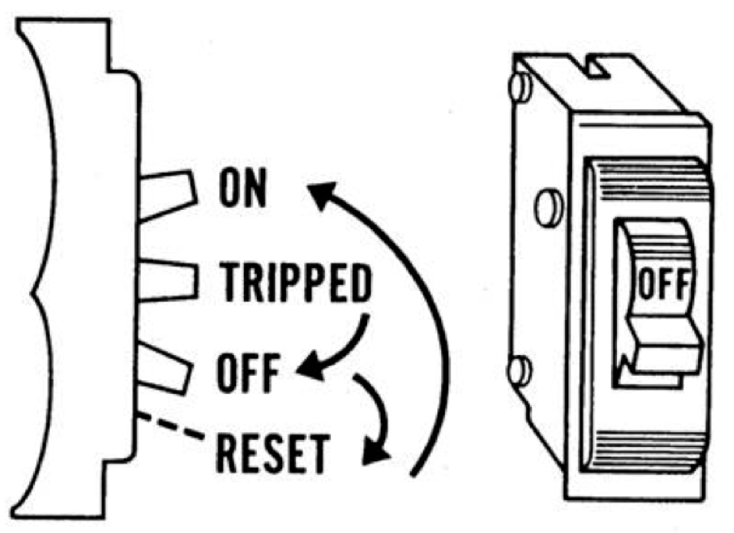
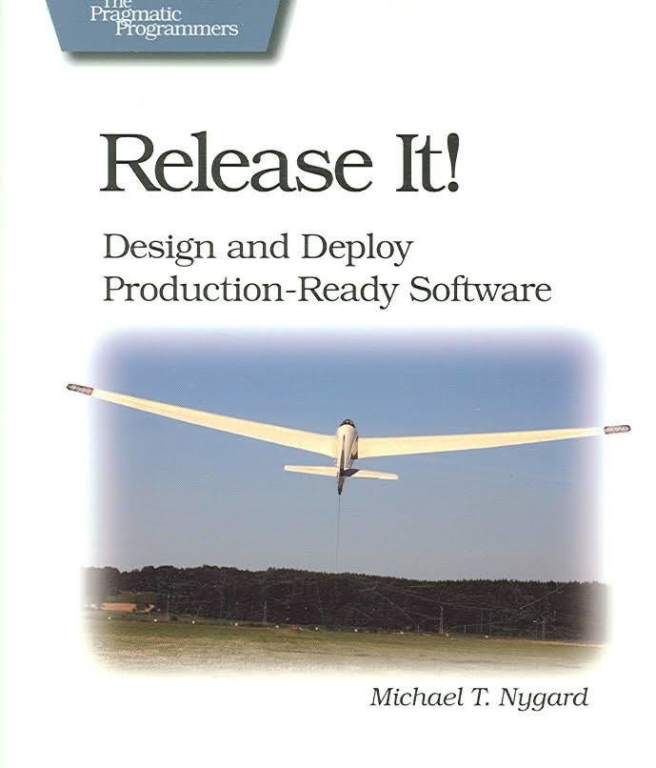
Circuit Breaker
How to guard a system by cascading failures and slow responses from other systems?

Slide 76
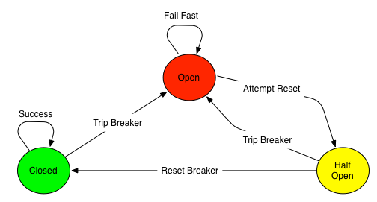
Circuit Breaker
How to guard a system by cascading failures and slow responses from other systems?

Slide 77
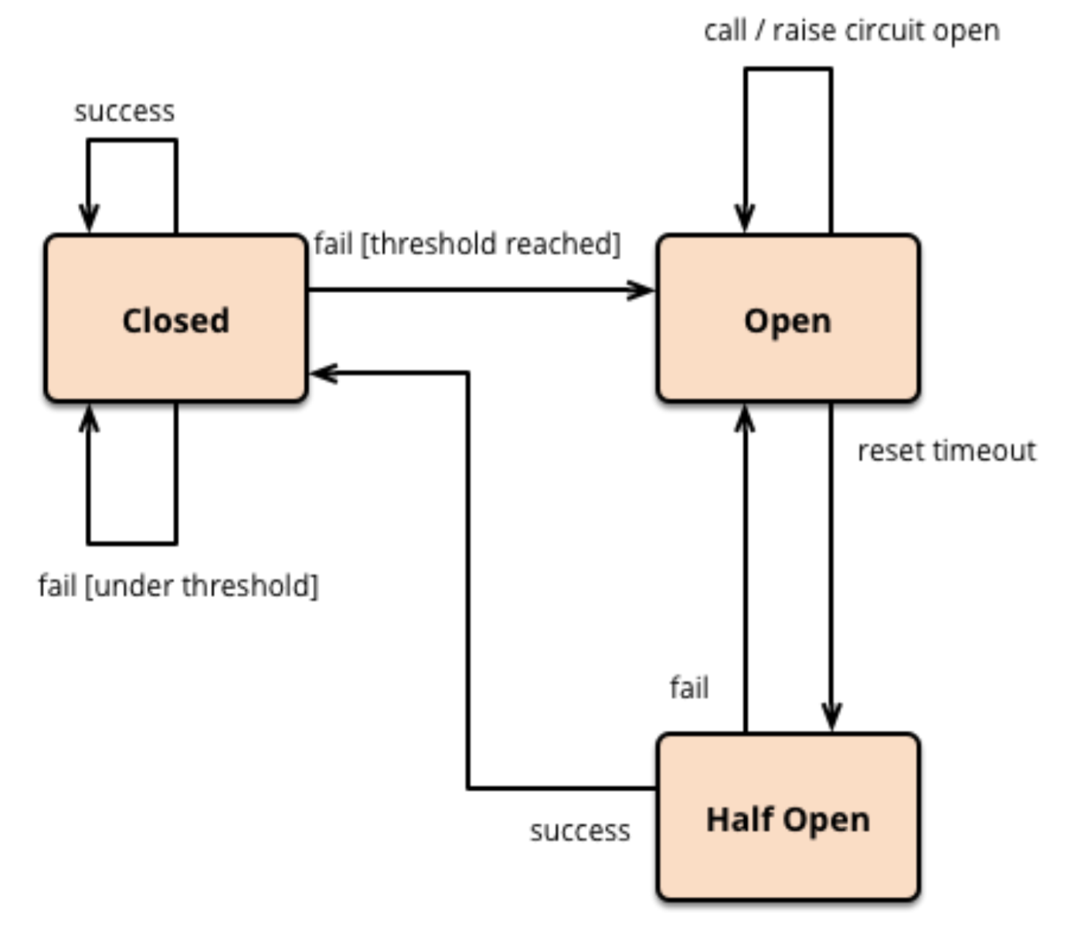

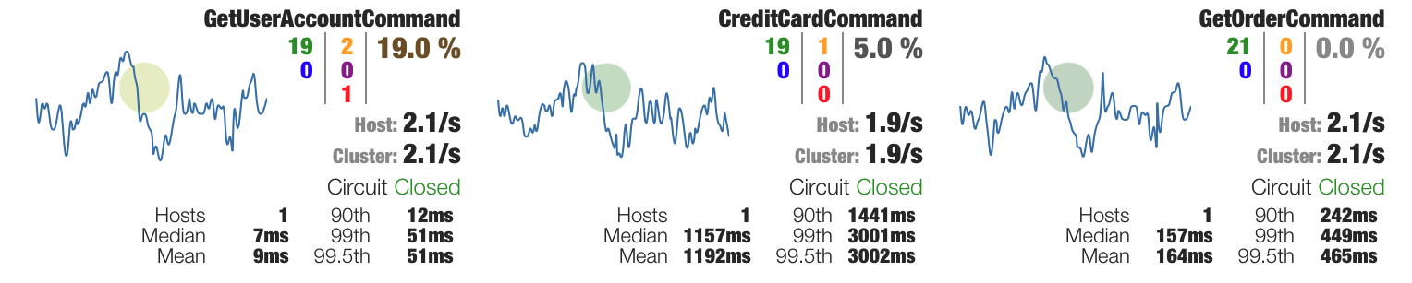
Circuit Breaker
Improves the stability and the resilience of a system by guarding integration points from cascading failures and slow responses.

Slide 78
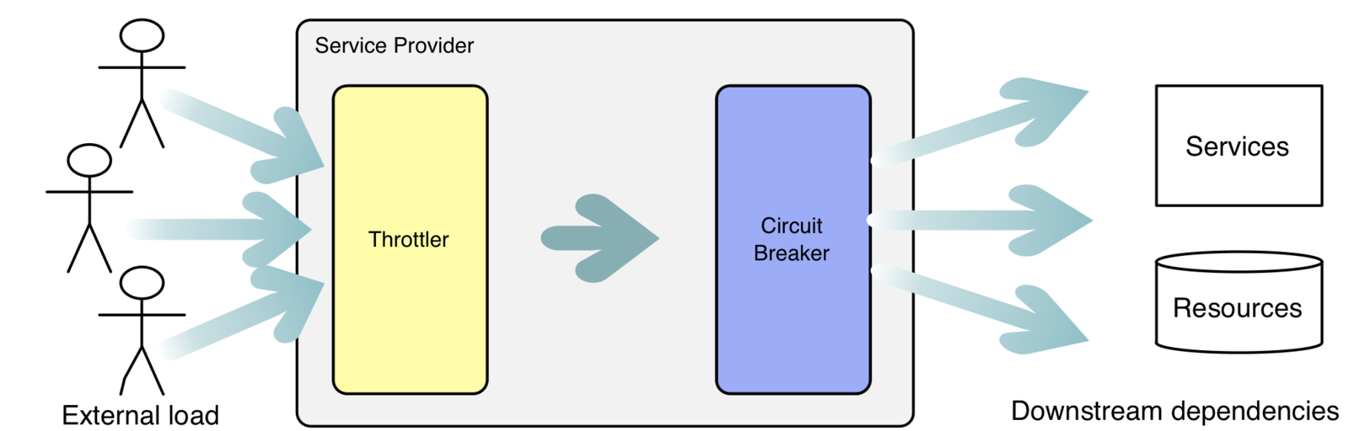
Circuit Breaker
Circuit Breaker vs Throttling
Throttler slows down and/or blocks calls to protect systems from high load
Circuit Breaker produces fast responses to protect from external system failures

Slide 79
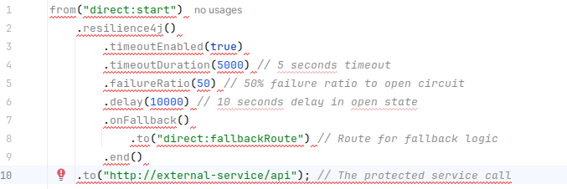
Circuit Breaker
Prevent repeated failures when interacting with an unreliable external service by “breaking” the circuit
Configure a circuit breaker with a timeout, failure ratio, and delay, along with a fallback route to handle failures when the circuit is open or a call fails
The circuit breaker operates in three states:
Closed: Calls are allowed to pass through to the protected service. If a configurable number of failures occur within a certain timeframe, the circuit transitions to the Open state.
Open: Calls are immediately rejected without attempting to reach the protected service. After a configurable delay, the circuit transitions to the Half-Open state.
Half-Open: A limited number of test calls are allowed to pass through to the protected service. If these calls succeed, the circuit returns to the Closed state; otherwise, it returns to the Open state.
Notes:
Integration with Resilience Libraries:
Apache Camel integrates with resilience libraries like Resilience4j (and historically Hystrix) to implement the Circuit Breaker EIP. Resilience4j is the recommended and actively maintained option.
Circuit Breaker EIP:
You can apply the Circuit Breaker EIP to a specific part of your Camel route that interacts with a potentially unreliable service. This EIP acts as a proxy, monitoring calls to the protected service.
Fallback Mechanism:
When the circuit is Open, or if a call fails while in the Closed or Half-Open state, you can define a fallback mechanism within your Camel route. This allows you to provide an alternative response or handle the failure gracefully without impacting the overall system.
Configuration:
You can configure various parameters for the circuit breaker, such as:
Failure thresholds (how many failures trigger the open state).
Timeout durations (how long to wait for a response from the protected service).
Delay in the open state before transitioning to half-open.
Number of calls in the half-open state.

Slide 80
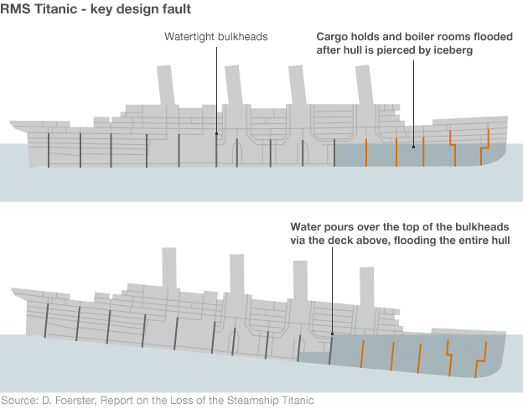
Bulkhead
How to enforce resource partitioning and damage containment in order to preserve partial functionality in the case of a failure?

Slide 81
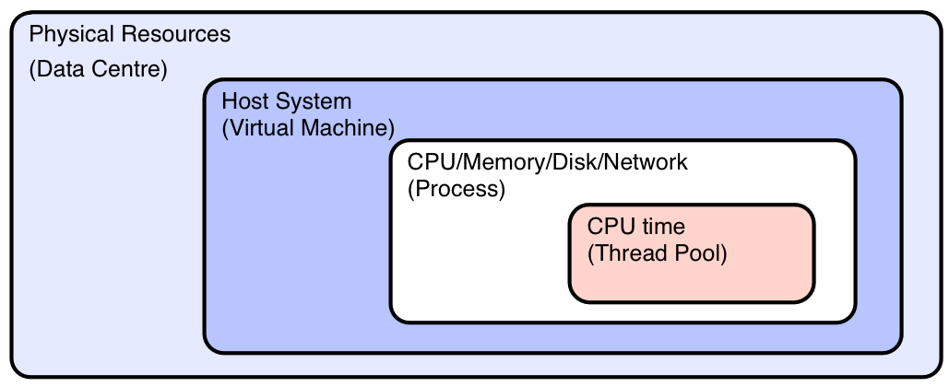
Bulkhead
Enforces resource partitioning and damage containment in order to preserve partial functionality in the case of a failure.
Possible Camel bulkhead points:
The Bulkhead pattern in Apache Camel, you can use the circuitBreaker() Enterprise Integration Pattern (EIP) with a Resilience4j or MicroProfile Fault Tolerance configuration.
The Bulkhead pattern uses limited-size thread pools or semaphores to restrict the number of concurrent calls to a specific downstream service. If the limit is reached, subsequent requests can be queued, rejected, or immediately handled by a fallback method, effectively isolating the failure.
  Resilience4j: This is the modern, lightweight, and actively maintained library recommended by the Camel community for implementing bulkheads.
  MicroProfile Fault Tolerance: This standard library also supports bulkhead and other resilience patterns, with dedicated Camel component support.

Slide 82
Bulkhead
Enforces resource partitioning and damage containment in order to preserve partial functionality in the case of a failure.
Best practices
Isolate slow services: Use the bulkhead pattern specifically on endpoints that are known to be slow or unreliable. Encapsulating these calls within a circuitBreaker() block ensures that issues with one service won't impact others.
Choose the right configuration: Experiment with bulkheadMaxConcurrentCalls and bulkheadMaxWaitDuration to find the right balance between protecting your system and allowing a reasonable number of concurrent requests.
Combine with other EIPs: The Bulkhead pattern works well with other resilience techniques. For example, you can combine it with the Circuit Breaker pattern (which automatically detects and "trips" on repeated failures) and a onFallback() to provide a graceful failure response.
Monitor your resilience: Implement monitoring to track the state of your bulkheads and observe whether requests are being accepted, queued, or rejected. This helps you understand the health of your system and adjust configurations as needed.

Slide 83

Bulkhead
Using a separate thread pool to process messages sent to the endpoint.
Notes:
Resilience4j bulkhead options:
bulkheadEnabled(true): Activates the bulkhead functionality.
bulkheadMaxConcurrentCalls(10): Sets the maximum number of concurrent executions to 10. Once this limit is reached, any new requests will be rejected by the bulkhead.
bulkheadMaxWaitDuration(2000L): Specifies the maximum amount of time a thread will wait to enter the bulkhead. If the wait times out, the thread is rejected.
onFallback(): Defines the logic to execute when a call is rejected by the bulkhead.

Slide 84

Horizontal Scaling
Service Instance Pattern for accommodating increasing workloads.
Notes:
Apache Camel can achieve horizontal scaling by deploying multiple instances of the same integration application, typically within a containerized environment like Kubernetes. Key to this approach is designing stateless integration applications and using a load balancer to distribute incoming traffic across these instances. For Camel K, automatic horizontal scaling can be enabled using Horizontal Pod Autoscaler (HPA) to scale based on metrics like the number of inflight exchanges, allowing for automatic scaling to zero in response to traffic changes

Slide 85
Service Instance
Areas to consider before horizontally scaling a Camel application.
Design for Statelessness
Remove State:
Applications must be designed to be stateless. This means that user-specific data should not be stored within the Camel application instances themselves but rather in an external, shared data store.
External Data Storage:
Store session data and other state in a central location, such as a database or a message queue, that all running Camel instances can access.
Leverage Orchestration and Load Balancing
Containerization:
Deploy your Camel integrations as containers, which is ideal for horizontal scaling.
Kubernetes/OpenShift:
Use platforms like Kubernetes or Red Hat OpenShift. These platforms handle the orchestration of your containerized applications, making it easier to scale them out.
Load Balancer:
A load balancer is crucial for distributing incoming requests across the multiple instances of your Camel application.

Slide 86
Service Instance
Areas to consider before horizontally scaling a Camel application.
Implement Autoscaling
Knative:
Camel 4 provides native support for scaling, particularly for integration and pipe resources.
Horizontal Pod Autoscaler (HPA):
Configure HPA to automatically adjust the number of pods for your Camel Integration or Pipe.
Custom Metrics:
You can export internal integration metrics, such as the number of in-flight exchanges, to use with Prometheus and the custom metrics adapter for HPA.
Scale to Zero:
With certain configurations, like using a Knative-enabled environment, Camel K pipes can automatically scale down to zero replicas when there is no incoming traffic, optimizing resource usage.
Ensure Proper Message Consumption
Message Brokers:
When consuming from a message broker like ActiveMQ, ensure that your deployed instances are competing for messages from the inbound queue. This is often a very effective way to increase throughput and utilize horizontal scaling.
Notes:
Autoscaling with HPA​​ An Integration can automatically scale based on its CPU utilization and custom metrics using horizontal pod autoscaling (HPA).
A Pipe can automatically scale based on its CPU utilization and custom metrics using horizontal pod autoscaling (HPA).
Apache Camel 4 supports horizontal scaling, primarily through its ability to run as a microservice in containerized environments like Kubernetes, combined with features for distributed processing
. The most common and effective approach is to use the Camel K sub-project, which is specifically designed for cloud-native deployments and integrates with Kubernetes' native scaling mechanisms.
Cloud-native horizontal scaling with Camel K
Camel K is the recommended runtime for deploying Camel 4 integrations on Kubernetes, where it leverages the platform's features for seamless horizontal scaling.
Kubernetes Horizontal Pod Autoscaler (HPA): This is the standard Kubernetes mechanism for scaling workloads. You can use it with Camel K to automatically increase or decrease the number of pods running your integration based on metrics like CPU utilization or memory usage.
KEDA (Kubernetes Event-Driven Autoscaling): For event-driven scenarios, KEDA is an advanced autoscaler that can scale Camel K integrations based on external event sources, such as the queue length of a messaging system like RabbitMQ, Kafka, or AWS SQS. This ensures your application only scales when there is work to be done, including scaling to zero replicas when idle.
Knative: If you are running Camel K on a cluster with Knative installed, you can automatically scale your integrations based on incoming HTTP traffic. This allows for rapid scaling up and down, including scaling to zero when there is no traffic.
Built-in Camel features for distributed processing
Beyond the runtime environment, Camel itself provides patterns and components that are essential for building horizontally scalable applications.
Idempotent Consumer: This Enterprise Integration Pattern (EIP) is crucial for processing messages reliably in a clustered environment. It prevents multiple instances of the same route from processing the same message twice. This is typically implemented with a shared "idempotent repository" backed by a database, Redis, or other external storage.
Master component: For use cases where only a single consumer should be active at any given time—such as with file processing or timers—the Master component ensures a leader election process across a cluster of Camel instances.
Message Queues (JMS/AMQP): When an integration uses a message queue as a consumer, horizontal scaling is a natural fit. Each running instance of the Camel route can consume messages from the queue in parallel, with the messaging system handling the distribution of the workload.
Saga EIP: This pattern helps manage long-running, distributed business transactions. It provides a coordination mechanism to ensure a set of actions across different services are either all successfully completed or fully compensated, which is key for reliable distributed processing.
Parallel Processing EIPs: For processing tasks within a single route, EIPs like Splitter and Multicast include a parallelProcessing option. While this scales the processing threads within a single Camel instance (vertical scaling), it is a foundational concept that complements horizontal scaling by optimizing resource usage per replica.
Considerations for implementing horizontal scaling
To achieve effective horizontal scaling with Apache Camel 4, consider these best practices:
Design for statelessness: Where possible, design your Camel routes to be stateless. This allows any instance to process any message, simplifying the scaling logic.
Use shared, external state: Use external, horizontally scalable systems (like databases or distributed caches) for shared state, locks, and idempotent repositories. This prevents individual instances from becoming a bottleneck.
Choose the right deployment model: While you can scale traditional Camel applications manually, using Camel K on Kubernetes is the most robust and automated method for dynamic, cloud-native horizontal scaling.

Slide 87

Scalability Scenarios
Vertical scaling (performance tuning)
Optimize thread pools: By default, some parallel processing patterns in Camel use a limited, shared thread pool. For demanding routes, define and configure dedicated thread pools with ExecutorService to prevent bottlenecks.
For parallel processing patterns (Multicast, Recipient List, Splitter): Override the default behavior by providing a custom ExecutorService tuned to your workload.
For asynchronous messaging with SEDA: Increase the concurrentConsumers property on the endpoint to allow more threads to process messages from an in-memory queue.
Fine-tune asynchronous and in-memory components: Apache Camel 4 has improved performance for its asynchronous messaging components.
SEDA vs. Disruptor: For high-throughput scenarios, consider the disruptor component, which has outperformed the seda component in Camel 4 performance tests. Disruptor is a lock-free, in-memory queue that can be faster in multi-producer, multi-consumer situations.
Stream large files: To avoid memory issues when processing large files on a single machine, use Camel's streaming capabilities. This prevents the entire file from being loaded into memory at once.
Inline Rest DSL routes: In Camel 4, the default value for inlineRoutes in restConfiguration is now true. If you define your REST API and then call a direct endpoint to process the request, inlining reduces the number of routes and the associated processing overhead.
The Rise and Fall of the Performance Monsters
Hunting Performance Monsters on the back of a Camel
Notes:
Performance tuning best practices
1. Optimize JVM settings
Use a modern JDK: Ensure you are running on a recent, long-term support (LTS) version of the JDK (e.g., JDK 21, now the default for Camel JBang) to benefit from the latest Garbage Collection and JIT compiler improvements.
Tune the JVM: Monitor and tune your Garbage Collector based on your application's memory usage and traffic patterns.
2. Disable or optimize JMX
Camel's JMX instrumentation provides useful monitoring but has a performance overhead, especially in high-throughput environments.
Disable if not needed: If you don't require JMX monitoring, disable it entirely.
Use a limited profile: If monitoring is necessary, choose a more lightweight JMX profile, such as RoutesOnly, to reduce the performance impact.
3. Control logging overhead
Excessive logging can significantly slow down high-throughput applications.
Reduce verbosity: Configure your production environment to log less detail.
Use an async logger: For critical logs, use an asynchronous logging framework like Log4j2 to avoid blocking your application threads.
Leverage Camel's ThroughputLogger: Log aggregated statistics over a fixed interval instead of logging every single message.
4. Prioritize message body over headers
Avoid overusing message headers and properties for business data. Storing too much state in headers makes the message unpredictable and can reduce performance.
Use Data Transfer Objects (DTOs): Transform incoming data into a well-defined DTO stored in the message body early in the route.
Reserve headers: Use headers only for transport-level metadata.
5. Choose the right component
Camel offers multiple components for similar functions, and some are more performant than others.
Select faster components: The Platform HTTP Vert.x component in Camel 4 has shown better performance than older HTTP components.
6. Address systemic bottlenecks
Sometimes, the performance bottleneck lies outside of the Camel application.
Tune your external systems: Adjust settings for databases, message brokers, and web servers to handle higher load. For example, increase connection pool sizes and configure native I/O connectors for web servers.
Optimize external calls: Ensure your route efficiently handles interactions with external services. Tune timeouts and connection settings to prevent resource exhaustion.
7. Profile your application
Use profiling tools to identify specific bottlenecks within your application.
Use async-profiler: The Camel development team has used this tool to pinpoint performance plateaus and areas needing optimization in Camel 4.
Target hot spots: Use a profiler to find the code paths that consume the most CPU time.

Slide 88

What did we cover so far?

Slide 89
Enterprise Integration Modernization

Slide 90



Red Hat build of Apache Camel
Connect APIs
Bridge different API architectural styles. Transform data formats in API calls. Route requests based on their content and aggregate responses.
Connect via Messaging and Industry Protocols
Bridge messages between different Broker technologies. Filter and validate messages based on the content and metadata. Prevent duplicate messages and retry failed deliveries. Consume and index messages from edge devices. Stream and partition large data for analysis and AI.
Versatile application development toolkit for Enterprise integration that simplifies and standardizes the practices of connecting diverse systems.
Connect Enterprise Systems and Cloud Services
Use pre-built connectors to integrate with SAP, Salesforce, Jira, LDAP, AWS, Azure, Google, OpenShift, OpenShift Serverless, and other services and products.
based on Apache Camel

Slide 91





















Accelerate development of enterprise integrations
with Red Hat build of Apache Camel for application developers
Pipes
XML
JSON
Kamelets
Integrate in Java applications
Compose integration microservices
Build low-code integration pipes
Connect variety of systems and services
Transform data from and to various formats and structures
{;}
XML data
SOAP | XSLT
JSON data
JWT | JSLT
Binary data
Protobuf | Avro
Non-structured data
PDF | TXT | CSV
Compressed data
Zip | LZF
Secured data
PGP | JCE
Healthcare data
FHIR | HL7

Slide 92







Enterprise Integration Modernization
Start
Assess:
- customer team,
- use cases,
- required camel components,
- performance profile,
- resource footprint
Need Application Platform?
YES
YES
NO, we will incorporate Camel to the customer’s development workflow and their application platform of choice
Running Fuse on Karaf / EAP and ready to refactor?
Red Hat build of Apache Camel 4
NO
Need low code / no code integrations?
YES
Kamelets, Pipes, Camel K Operator
Running Fuse on Spring Boot 2 and ready to update to Spring Boot 3 and JDK17?
Need Red Hat’s runtime cloud-native framework?
Red Hat build of Quarkus
YES
YES
Need messaging or streaming data?
Red Hat AMQ Broker
Red Hat AMQ Streams
NO
YES
Extended Life Support for
Need IDE?
YES
Red Hat OpenShift Dev Spaces
Still unsure?
is ready to help customers accelerate their migration from Red Hat Fuse to newer versions of Camel with automation that handles their custom routes.
Notes:
Solution pattern - templates with placeholders for code and configuration from Fuse projects

Slide 93


Get Started with Camel
Getting started guides in Product documentation
Hands-on Tutorials in Developer Sandbox
Expose legacy SOAP web service using REST API
Day in the life of Camel
Cloud-native integration with Camel
Cloud architecture
Edge to Core data pipelines
Workshops
Solution patterns
Fuse to Camel
Data pipelines for AI
Explore without local installs
Quickstarts
Quarkus quickstarts
Spring Boot quickstarts
Kaoto examples
SAP quickstarts
HawtIO examples
MQTT and ElasticSearch
Monitoring with Micrometer, Prometheus and Grafana
Message bridge between AMQ and IBM MQ with connection pooling and XA transactions
ETL between multiple JDBC data sources
JPA Idempotent repository
AMQP and Salesforce

Slide 94



















Extended capabilities for developer productivity
APPLICATION DEVELOPMENT & DELIVERY PLATFORM
Trial & Onboarding |  | Inner Loop (for Code, Build, Debug and Push) |  | Outer Loop (for Code review, Compliance, Security, Test and Deploy)
 | Developer Sandbox Fastest and least friction way, at zero cost, for a developer to try our OpenShift platform, key developer tools and services, and Red Hat cloud services. https://developers.redhat.com/developer-sandbox OpenShift Local Formerly known as “Red Hat CodeReady Containers” Pre-built development environment, based on OpenShift v4, for quick container-based application development - on developer laptops. https://developers.redhat.com/products/openshift-local/overview Developer Hub Backstage-based customizable, self-managed developer portal that simplifies developer onboarding with broad self-service capabilities focused on developer workflows for containerized applications. |  | Podman Desktop This upstream project enables developers to easily build and share containerized applications, facilitating their transition to Kubernetes. https://podman.io Docker Desktop extension Enables deployment of local images to OpenShift directly from Docker Desktop. https://github.com/redhat-developer/openshift-dd-ext OpenShift Dev Spaces Formerly Red Hat CodeReady Workspaces Centralized, shareable, in-browser Kubernetes-based Integrated Development Environment, focused on OpenShift customers. https://developers.redhat.com/products/openshift-dev-spaces/overview OpenShift Toolkit IDE Extension (VSCode, IntelliJ) Developers can easily create, deploy and live debug container applications running on OpenShift. https://marketplace.visualstudio.com/items?itemName=redhat.vscode-openshift-connector https://plugins.jetbrains.com/plugin/12030-openshift-toolkit-by-red-hat IDE Extensions (Visual Studio Code, IntelliJ) for Languages (Java, XML, YAML, Apache Camel) and Runtimes (Quarkus, EAP) Makes it easy for developers to build cloud-native and hybrid cloud applications with RH supported languages, and use RH preferred runtimes. CLI tools: odo OpenShift Developer CLI (command-line interface) that helps developers to build on Kubernetes/OpenShift, hiding Kubernetes complexity and supporting developers to get up and running Maven/Grade tooling (JKube) Adds the ability to bring Java applications to Kubernetes by extending native Maven/Gradle packaging tools. Trusted Content Currently available as “Dependency Analytics” “ Provides trusted open source software packages and dependencies, vulnerability information, and remediations engineered by Red Hat, delivered to developer’s IDEs. |  | Trusted Application Pipeline SaaS offering that provides an OOTB customizable secure software supply chain that enables platform engineers and developers to easily build and deliver secure Kubernetes applications across multiple cloud environments. Plug-ins for CI/CD tools (GitHub Actions, Microsoft Azure DevOps, GitLab Runner, Jenkins) Provide templates for automated deployment of applications to OpenShift OpenShift Pipelines, Tekton Hub, Tekton IDE extension Is a cloud-native CI/CD solution to securely build containerized applications and deploy to OpenShift. Tekton Hub provides a catalog of Tekton task templates. Tekton IDE extension enables developers to create and manage Tekton pipelines from their IDE IDE Extensions (for Visual Studio Code, IntelliJ, Eclipse) for Deployment (OpenShift Toolkit, Serverless Functions) Enable developers to push their code to OpenShift without needing to build containers, and to also configure serverless deployments. OpenShift GitOps Enables developers to declare and version application and cluster configuration in Git, automate application deployments, configuration drift detection and remediation. kam (Kubernetes application management) enables developers to easily seed GitOps declarative application models in Git. Plug-ins for Backstage Expands Developer Hub and self-installed Backstage environments with self-service capabilities to build, store, deploy, and monitor containerized applications across multiple clusters. OpenShift UI tools: OpenShift Dev Console Provides an end-to-end developer experience in OpenShift, across all cloud platforms, for building, deploying, and managing containerized applications and their related services. Web Terminal Runs within the OpenShift Dev Console. It provides a command line interface, pre-loaded with developer-focused CLIs. Helm is a package manager for Kubernetes. We provide support for that packaging in OpenShift, and a certified catalog for developers to quickly create applications based on curated Helm charts.
Notes:
But what is OpenShift Serverless ? OpenShift Serverless packages Knative Serving, Eventing and extend it by adding Functions capabilities and provide an operator based installation that is great for production environments. The operator takes care of upgrades, updates and the necessary integration many other services provided by OpenShift, such as Logging, Metering, etc. OpenShift Serverless also comes with a great developer experience and we are going to take a quick look into that right now.

Slide 95
Thank you
Red Hat is the world’s leading provider of enterprise open source software solutions. Award-winning support, training, and consulting services make
Red Hat a trusted adviser to the Fortune 500.

Slide 96
Features that have come out of Camel-k and moved to the core
camel-jbang ( a lot of the low-code, quick run, prototype, export stuff) is inspired by camel-k, via its kamel run foo.yaml
kamelets
route-templates
bindings
yaml-dsl (also pipe yaml)
configuring beans in yaml-dsl
dynamic route-loader
improved health checks
java dsl compiled at runtime, so you can do hot-reload
more metadata in camel-catalog for tooling/build
camel-knative component
camel-webhook component
camel-cron component
camel-platform-http (to adapt to SB or Q) for embedded http server
camel-kubernetes (support for configmap/secrets ala CK style)
routes/kamelets can have "conditions" that allow to turn on/off parts based on runtime platform
data-types
camel-cloudevents
exchange pooling (rhoc for low memory usage)
camel-main (to have reusable camel startup with SB and Q)
more robust and fault tolerant camel-kafka (rhoc)
secret/configmap properties functions
route builder interceptor
better supervised controller

Slide 97
Camel Pre-built Connectors
Accelerate connecting between services and systems
APIs - REST, WS SOAP, OpenAPI, gRPC, Websocket, Webhook
Common - HTTP, Mail, Mock, Validator, Crypto
DB / Storage - SQL, JPA, JTA, JDBC, MyBatis, MinIO, File, FTP
AWS Services - DynamoDB, Lambda, S3, SNS, SQS, …
Azure Services - Storage Blob, Storage Queue, Service Bus, …
Google Services - BigQuery, PubSub, …
Scheduling - Cron, Timer, Quartz, Scheduler
Messaging - JMS, AMQP, MQTT (Paho), Kafka, NATS, Slack, Telegram
Monitoring - Micrometer, Splunk, OpenTelemetry
Caching - Infinispan
Enterprise - LDAP, Jira, SAP, Salesforce

Slide 98
Key Capabilities of Camel

Slide 99

Camel for Quarkus
APPLICATION FOUNDATIONS
Framework addressing wide range of distributed application architectures
Containers First
Serverless characteristics
Unified configuration
Dev mode with live reload
Kubernetes-native
Hundreds of best-of-breed standard libraries
Quarkus
Latest Camel v4 (lighter, faster)
Container-based environments
Flash boot time
Minimal memory footprint
Standalone & OpenShift
Highly advanced integrations
Custom flows with full control
Long-term support commitment
Integration swiss knife
Super lightweight
Connectors
Most popular Integration
Framework
Camel for Quarkus
Camel

Slide 100

Camel for Spring Boot
APPLICATION FOUNDATIONS
World's most popular java framework
Focus on speed, simplicity and productivity
For stand-alone Spring applications
Opinionated with simplified build configuration
Many out of the box solutions
Spring Boot
Latest Camel v4 (lighter, faster)
Container-based environments
Camel context with automatic detection of Camel routes
Auto-configuration of Camel components
Starters for many Camel pre-built components
Highly advanced integrations
Custom flows with full control
Long-term support commitment
Integration swiss knife
Super lightweight
Connectors
Most popular Integration
Framework
Camel for Spring Boot
Camel

Slide 101
CAMEL DEV TOOLS
for simple creation and testing of Camel routes
VS Code extensions
  Language Support for Apache Camel by Red Hat
  Debug Adapter for Apache Camel by Red Hat
Camel CLI for rapid integration prototyping
Camel REST DSL OpenApi Maven Plugin
generates REST DSL source code from OpenAPI specification
CXF SOAP Development Tools
Java to WSDL, WSDL to Java, WSDL Validator
Development support

Slide 102


Developing Camel integration routes
using Kaoto visual designer in VS Code
Focus on solving integration business problems
Access to catalog of Camel components and patterns
Features like auto-completion, configuration forms, and interactive feedback to speed up development.
Kaoto guide to install and get started with

Slide 103

Kaoto in Visual Studio Code
Run with Camel CLI
Debug with Debug Adapter
Language support for syntax highlighting and autocompletion
Visual Designer for Camel

Slide 104




Iterative development for integration solutions
From prototype to a full Camel java-based project
Start with defining integration without boilerplate code in editor or Kaoto visual designer
Run integration designs
Troubleshoot and refine integrations using Camel CLI, Debug adapter and HawtIO
Iterate and experiment
create
camel export --runtime=quarkus --gav=com.foo:acme:1.0-SNAPSHOT
Log & watch
Debug
Manage
Monitor
camel init routesA.xml
CI/CD
camel run * --dev
commit
hot reload
Notes:
As soon as developers decide to prototype an integration, Camel CLI allows them to dive right into defining the integration logic. They don't have to deal with bootstrapping projects and setting up complexities. Instead, they can focus on the functionality. This is enabled by smart automation which handle automatic dependency resolution, project building and other typical repeatable tasks in the background of the development process.
With the setup and dependencies out of the way, the next step is to iterate and refine integration. Camel CLI encourages rapid prototyping by allowing easy adjustments and modifications. This flexibility is crucial for testing different scenarios and finding the most effective integration approach. With the combination of Camel CLI, Debug adapter and HawtIO diagnostic console developers can troubleshoot and refine integrations as the tools enable to watch integration behavior and message exchanges.
Once the prototype meets expectations, Camel CLI makes it simple to transition from a prototype to a project by exporting it to a full Camel Java-based project.

Slide 105
Camel on OpenShift
Some components (S3) contribute to the readiness status of application - if a connection is not established, the pod becomes “not ready”
Notes:
Runs on top of Quarkus
Handles Camel dependencies for you (no pom.xml or project & dependencies descriptors)
Removes the need to configure Docker or S2I before deploying to OpenShift or Kubernetes

Slide 106

HawtIO diagnostic console
for troubleshooting and debugging Camel routes
React + PatternFly v4
New plugin mechanism
Standalone -> Hawtio v4
OpenShift -> Hawtio Online v2
Camel plugin
  Contexts/Routes/Endpoints
  Route diagram
  Trace/Debug
  Source
  Simple statistics
Other plugins - Connect, JMX, OAuth (Keycloak), Artemis
Quarkus (JVM only) and SpringBoot

Slide 107
Migration from Fuse to Camel

Slide 108
COMMON MIGRATION PATHS
Quarkus ecosystem includes many of libraries and services common in JBoss
Red Hat Fuse 7
Enterprise Integration
Fuse on EAP
Red Hat build of Apache Camel 4 for Quarkus 3
Fuse on Karaf
Camel Operator
Red Hat build of Apache Camel 4 for Spring Boot 3
Fuse on Spring Boot 2
Effortless integration with Camel context and Camel SpringBoot starters

Slide 109







Fuse to Camel
RED HAT SERVICES SOLUTION: FUSE TO CAMEL MODERNIZATION
Service Offering
Collaboration
Proof of Value
1 Week
Navigate and Sketch
2 Weeks
MVP Solution & Validation
10-12 Weeks
Scaled delivery
varies by customer
Pilot Engagement
Increment 2 and beyond
Pre-sales
Consulting
Red Hat leads
Customer leads
Notes:
https://docs.google.com/presentation/d/1NBVc_4hGgKQZZm8tFpI3iY5kWhLfUtfHvzud-zY5D0c/edit#slide=id.ge1250ef5e6_0_0

Slide 110
Deprecated and discouraged Camel components
Deprecated / discouraged component | Recommendation
Spring XML DSL | XML IO DSL for much higher performance
ActiveMQ | JMS, AMQP
Undertow | HTTP
Dozer | Mapstruct
AtlasMap | JQ, JSLT, XJ, XSLT
Ehcache | Infinispan
OpenTracing | OpenTelemetry
Metrics, Microprofile-metrics | Micrometer
Deprecated / discouraged component | Recommendation
AHC-WS | VertX Websocket
Exec | A custom Processor, due to security reasons
CDI | Quarkus CDI, Spring annotations
DirectVM, VM | Direct, only 1 Camel context
ElasticSearch-REST | ElasticSearch
REST-Swagger, Swagger-Java | OpenAPI-Java
BeanIO, CSV | Bindy

Slide 111
System A
Transport A
Transport B
System B
Data
Route

Slide 112

Integration Architectures
Notes:
If we look where Camel started…
Platform features
Based on good principles that are still valid: Contract first, Service loose coupling, Service reusability, Service composability, Service statelessness
Centralized software and team, business logic leaking into the platform, slow to change and evolve, bottleneck for change, not-cloud friendly, not immutable infra friendly...

Slide 113

Very old SOA/ESB Architecture
Notes:
If we look where Camel started…
Platform features
Based on good principles that are still valid: Contract first, Service loose coupling, Service reusability, Service composability, Service statelessness
Centralized software and team, business logic leaking into the platform, slow to change and evolve, bottleneck for change, not-cloud friendly, not immutable infra friendly...

Slide 114

Today's ESB Architecture
App
App
App
App
Application
App
App
App
App
App
App
App
App
Integration
Apache
Camel
Apache
CXF
Apache ActiveMQ
Manage
Blueprint
HTTP
Core
Apache Karaf
Deployer
Shell
Config
OSGi Framework
Notes:
If we look where Camel started…
Platform features
Based on good principles that are still valid: Contract first, Service loose coupling, Service reusability, Service composability, Service statelessness
Centralized software and team, business logic leaking into the platform, slow to change and evolve, bottleneck for change, not-cloud friendly, not immutable infra friendly...

Slide 115
Integration Architectures
Notes:
Microservices came as a cure for SOA. SOA - optimized for changed
MSA before Kubernetes
Camel changes:
HTTP/REST DSL
Circuit Breaker
Saga pattern
Choreography
VM, Netflix, good principles. config server, deployment, etc.
Unopinionated
Trading development complexity for operational complexity

Slide 116


Microservice Architecture (MSA 1.0)
Data
store
SaaS
Notes:
Microservices came as a cure for SOA. SOA - optimized for changed
MSA before Kubernetes
Camel changes:
HTTP/REST DSL
Circuit Breaker
Saga pattern
Choreography
VM, Netflix, good principles. config server, deployment, etc.
Unopinionated
Trading development complexity for operational complexity

Slide 117
Today's Microservice Architecture (MSA 1.0)
Application
App
Integration
Apache
Camel
Spring Rest
Hystrix Circuit Breaker
Spring Framework
Spring Boot
Core
Spring Boot
Apache Tomcat
Notes:
Microservices came as a cure for SOA. SOA - optimized for changed
MSA before Kubernetes
Camel changes:
HTTP/REST DSL
Circuit Breaker
Saga pattern
Choreography
VM, Netflix, good principles. config server, deployment, etc.
Unopinionated
Trading development complexity for operational complexity

Slide 118
Integration Architectures
Notes:
Next-gen msa
Containers and Kubernetes
Camel integrated- healthchecks, config, discovery…immutable containers

Slide 119
Cloud Native Architecture
Application
App
Integration
Core
Camel
Service Mesh
Sidecar
Camel Spring Boot
Spring Boot
Tomcat
Pod
Notes:
Next-gen msa
Containers and Kubernetes
Camel integrated- healthchecks, config, discovery…immutable containers

Slide 120
Cloud Native Architecture
Application
App
Integration
Core
Camel
Service Mesh
Sidecar
Camel Main
Pod
Notes:
Next-gen msa
Containers and Kubernetes
Camel integrated- healthchecks, config, discovery…immutable containers

Slide 121

Cloud Native Architecture
Application
App
Integration
Camel
Service Mesh
Sidecar
Camel Quarkus
Core
Quarkus
Pod
Notes:
Next-gen msa
Containers and Kubernetes
Camel integrated- healthchecks, config, discovery…immutable containers

Slide 122

Serverless Architecture
K
Application
App
Integration
Core
Camel
Knative
Sidecar
Camel K
Pod
Notes:
Next-gen msa
Containers and Kubernetes
Camel integrated- healthchecks, config, discovery…immutable containers

Slide 123






Serverless Requirements
For the platform
Scaling to zero
Rapid scaling up and down
Eventing mechanism
Routing and networking
For the application runtime
Fast startup
Fast first response
Low on memory and CPU
Small size on disk
K
Notes:
Serverless enables developers to focus on applications that consist of event-driven
functions that respond to a variety of triggers and let the platform take care of the rest
- such as trigger-to-function logic, information passing from one function to another
function, auto-provisioning of container and run-time (when, where, and what), autoscaling,
identity management, etc.
Typically stateless, immutable and ephemeral deployments. Each function runs
with a specified role and well-defined/limited access to resources.

Slide 124
Camel CLI
https://docs.google.com/presentation/d/10BrgzUFaJssZkKPxgAclIkzu2LFYZG-qDc5k6cLNDQs/edit#slide=id.p

Slide 125
Content-based Router
Content-based Router receives a message and examines the content of the message to determine its destination

Slide 126
Message Filter
Message filter passes the message to another channel if the message content matches certain criteria, otherwise discards the message
Filter predicate evaluates to either true or false based on the message content
<order>
<orderId>100</orderId>
<shippingAddress>
<zipCode>22322</zipCode>
</shippingAddress>
</order>
<XML Message>
<Java DSL>
from("direct:a")
.filter(header("foo").isEqualTo("bar")))
.filter(body().convertToString().contains("MyValue"))
.filter().jsonpath("$.[?(@.customerId == '${header.ID}')]")
.to("direct:b")
from("file:orders/incoming?include=order.*xml")
.filter(xpath("/order/orderId/text() = 'Hello World'"))
.to("file:orders/outgoing/?fileExist=Fail");
.end()

Slide 127



SCAN TO EXPLORE
Take it with you
The site
Workshops & Tutorials
Chapters, runnable Camel routes, and the labs
The whole series: every workshop, tutorial, and deck in one place
patterncatalyst.github.io/enterprise-integration-patterns-with-camel
patterncatalyst.github.io/patterncatalyst-workshops-tutorials-list
127

